Slide 1
Primary Colours
Secondary Colours
Springbrook – 1099 Processing

Slide 2
Agenda
Forms and Documentation
AP – 1099 Processing – Batch setup and Settings
Invoices
Edit
Proof List
Forms
Export

Slide 3
1099 Due Dates
Refer to the IRS instructions for reporting deadlines.
1099-NEC – Non-employee compensation 1/31/2025 due date.
1099-R – Pension distributions are due 1/31/2025.
Others due 3/31/2025.

Slide 4
Order the correct forms
The Solv Group (formerly Centro) - 800.388.3650 https://tinyurl.com/SpringbrookEnter
Order Forms – Assure line-up is correct.
Please do not order forms from any other vendor. Springbrook tests this one vendor forms for line-up.

Slide 5
IRS Documentation
General 1099 information
2024 General Instructions for Certain Information Returns (irs.gov)
Download instructions from the IRS.
Instructions for Form 1099-MISC and Form 1099-NEC
Instructions for Form 1099-R

Slide 6
Two filing options 1. E-file information returns with IRIS (Information Returns Intake System) Website is: https://la.www4.irs.gov/irportal/
You will need one ID.me account from the IRS
You need an IRIS Transmitter Control Code (TCC)
2. Filing Information Returns Electronically (FIRE)
You need a FIRE Transmitter Control Code (TCC)
This is the old option that will be going away and replaced by IRIS

Slide 7
Two filing options
If you are required to file 10 or more information returns during the year, you must file electronically. The 10-or-more requirement is a total returns in a calendar year.
FIRE production system availability starts on January 13, 2025

Slide 8
1099 Processing - Batch
1099’s can be used as a single batch process.
Now you can multiple 1099’s batches open.
Highlight the batch by clicking on it.
Use the delete key on the keyboard to delete the batch.
Say yes to the warning. All data in the batch will be deleted.
Use the enter key to get the new batch setup window.
The batch year does not matter for 1099’s.

Slide 9
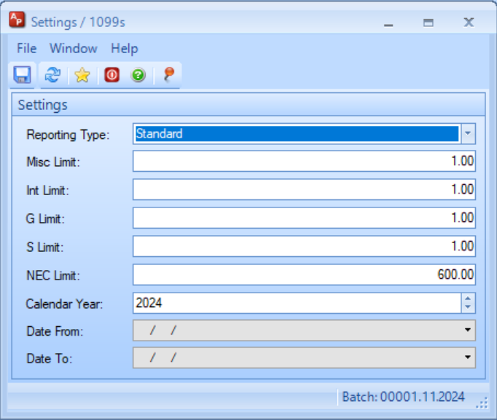
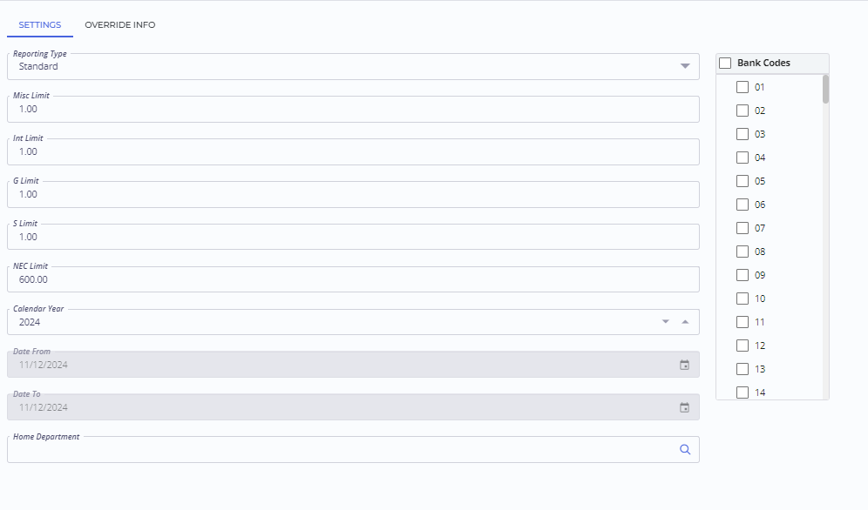
Settings
Reporting Type - Use Standard
Contract is only used for California Contractor reporting.
Calendar Year 2024. All history with check date in 2024 will be included.
Limit – Restricts 1099’s produced to include only vendors with the limit amount or more in 1099 checks.
Change to versions 7.18+ only. - Can have separate limits for various types.
Fill in all the boxes.

Slide 10
Invoices
This step allows you to modify actual AP history to change 1099 types or make invoices not 1099 (for supplies or any other reason).
Come back to this step after Generating if you have not previously identified invoices that need to be changed.
Do not manually edit 1099’s before backing up to this step. Generate will over-write manual changes.
The Vendor 1099 cannot be modified in this window and vendors can be accessed and changed.
Click on the Vendor number to open the vendor to change the 1099 settings.

Slide 11
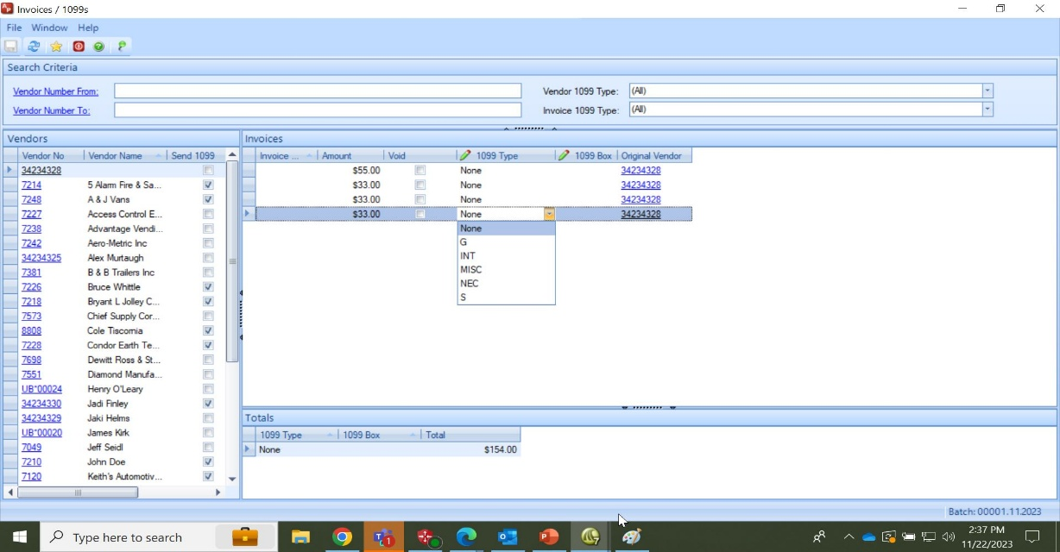
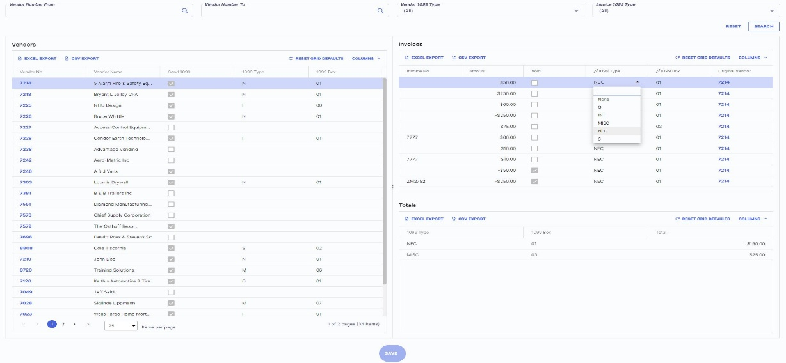
Invoices
Majority of your time will be spent looking at and editing your 1099 Invoice Type.
Filters can be added to limit data displayed.
Will only display check data within the year selected.
Can filter by Vendor or Invoice 1099 Type.

Slide 12
Invoice window

Slide 13
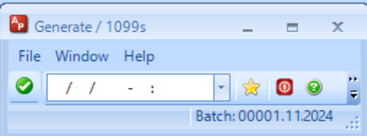
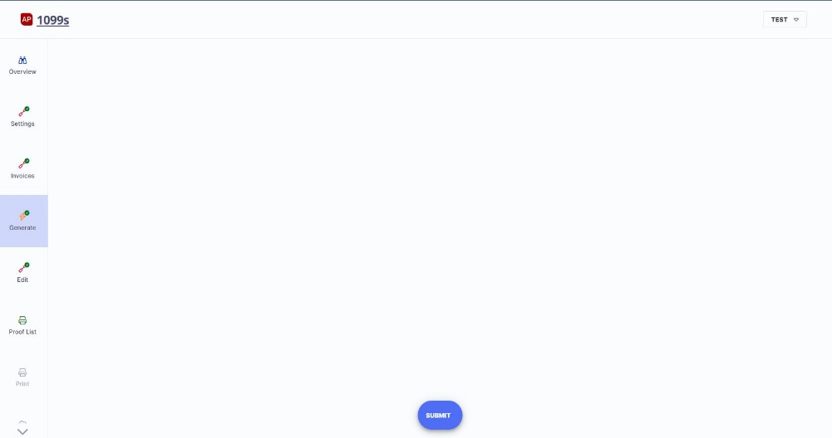
Generate
Generate will delete any 1099 data in the batch Edit step and over-write with system data.
Don’t go back and Generate if you have added or modified data in the Edit step.
Tip: Review generated data to make sure you have everything you expect before doing an editing. Hopefully no or minimal editing is needed. The 1099 data will match data in AP History.

Slide 14
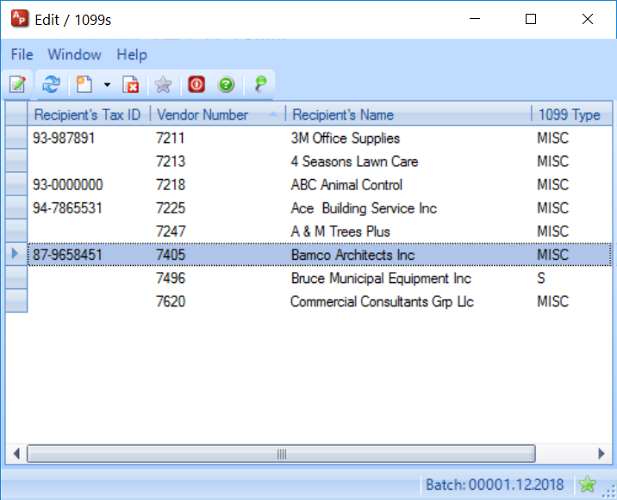
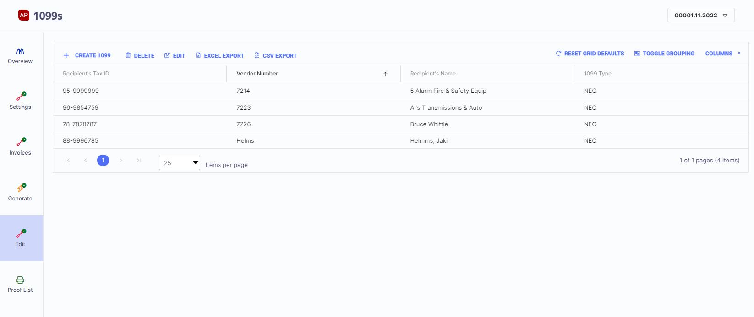
Edit
Fix the vendor and generate again if necessary. Do not modify vendor data in the Edit step if possible. Forms pull from vendor master information.
No vendor should have a blank Tax ID number. If you see this be sure to review and fix the vendor, then generate again.

Slide 15
1099 Detail
Double click or Modify in the Edit Window to see the 1099 Detail.
If history is correct there should be little or no need to edit any 1099 information.
You can view but not edit DBA information. If incorrect you should fix the vendor and regenerate.
May need to add withholding amounts since the system doesn’t track those.
It is always better to fix the history than Edit if possible.

Slide 16
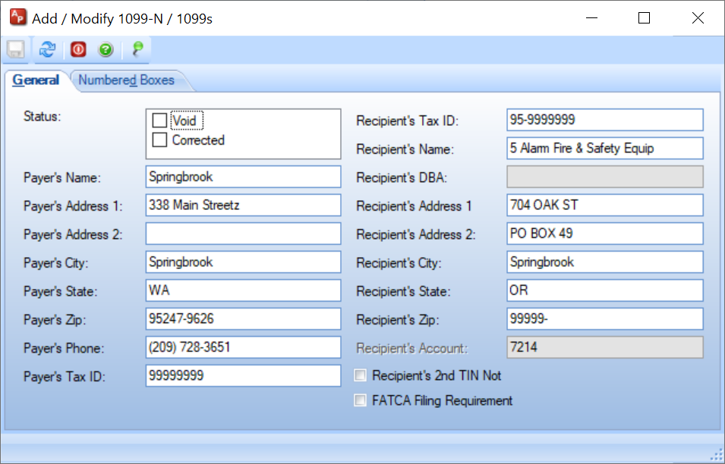
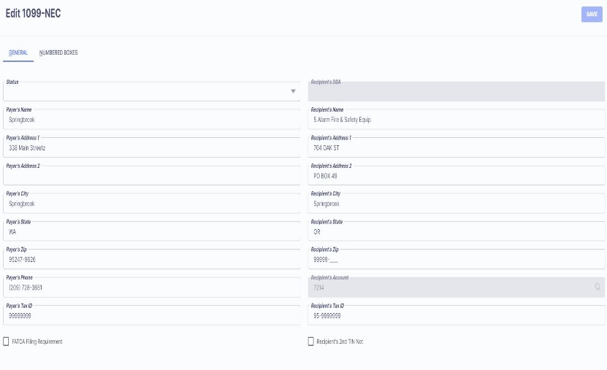
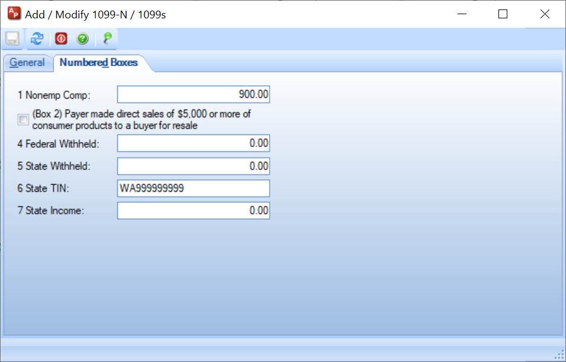
1099 Detail

Slide 17
DBA’s – Doing Business As
If a vendor has a DBA on their vendor master, it will print on the 1099. No setup needed.
If you record the DBA in the Address 1 field on the vendor, that will print on the 1099.
You may need to switch the information to get the DBA to print the way you want it on the 1099.

Slide 18
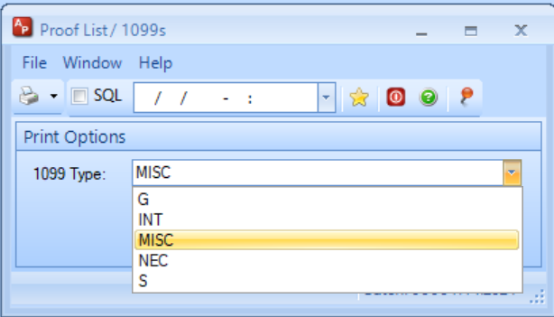
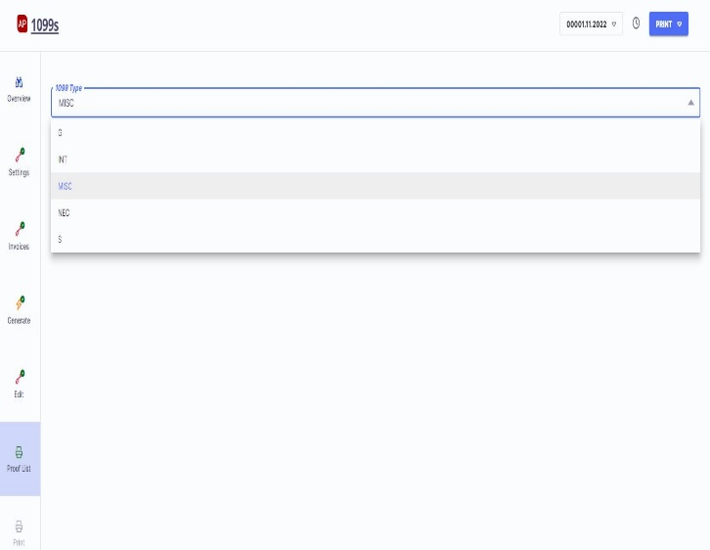
Proof List
Select the Type – Only one type can be run at a time. Each Type displays different information.
Can use totals to balance if desired.

Slide 19
Proof List fields by 1099 Type
NEC
Vendor
Tax ID
Non Employee Compensation
Federal Tax Withheld
State Tax Withheld
State Income
State Tax ID
Misc
Vendor
Tax ID
Rents
Royalties
Other
Fed Tax
Fishing Boat
Medical
Non Employee
Substitute
Crop Ins
Atty Proceeds
G
Vendor
Tax ID
Unemployment Comp
State Tax Refunds
Federal Income Tx
ATAA Payments
Taxable Grants
Agriculture Payments
Int
Vendor
Tax ID
Int Income
Early Withdrawal
Int on Bonds
Fed Income Tax
Inv Expense
Foreign Tax Pd
Tax-emempt Int
Private Bond
S
Vendor
Vendor Name
Tax ID
Gross Proceeds
Buyer’s Real Estate Tax

Slide 20
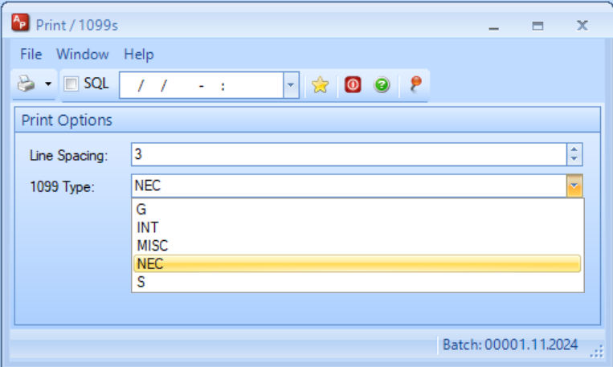
Print
Select the 1099 Type
Set Line Spacing to 3 to start. That is the spacing we test forms against to allow the forms to be moved up or down.
Default is 1 but 3 should be the expected setting.
ONLY use approved forms.

Slide 21
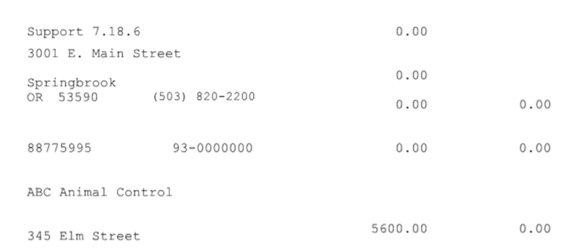
Forms
Print a form to plain paper and hold up to the light to check alignment before printing all of them. Check both top and bottom forms.

Slide 22
1099 Forms
1099-NEC
1099-Misc
1099-G
1099-Int
1099-S
1099-R – Processed in Payroll

Slide 23
1099 Copy A
Note about Forms printed – Springbrook does not test line ups to print on the red printed form. If you print these forms, you may need to do some adjusting to print on them. We expect all clients to electronically file rather than file on paper.

Slide 24
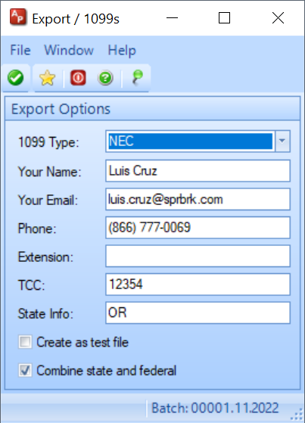
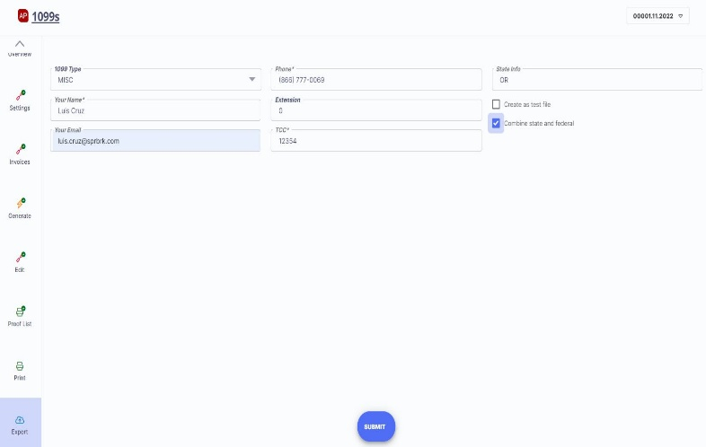
Export
File will be created to import into the FIRE or IRIS system.
You should have a TCC number and login.
Springbrook may not know if your state allows combined state and federal but have made changes to only list states that are on the FIRE instructions to include states that are allowed.
That will exclude vendor state information for vendors in states that cannot be reported to the FIRE system as combined. Federal information will be included.

Slide 25
End of Year Batch Numbers for Accounts Payable
Batch numbers and years are not important for Accounts Payable checks. The batch number will not affect the 1099 information generated.
Check dates are the critical item to get 1099 information processed to the correct calendar year.
Update Check dates and numbers utility in Bank Reconciliation > Utilities exists in versions 7.15+ to allow users to change check dates and numbers without Springbrook intervention.

Slide 26
Join Us on Community
In Springbrook Community (top of window), click on Connect and select Springbrook Enterprise. Make sure you are a member of this group. If not, there will be a box to Join the group.
After joining (or if you are already a member) sign up in the middle of the top to receive information in a Weekly Digest. The choices are Every Post, Daily Digest or Weekly Digest. Weekly digest will send an email every weekend with new information posted which works well for most clients. Limited will not send emails (I don’t think).
This will send an email on the frequency you request to remind you that new service packs are shipped. These items are all posted to Community Chat.

Slide 27
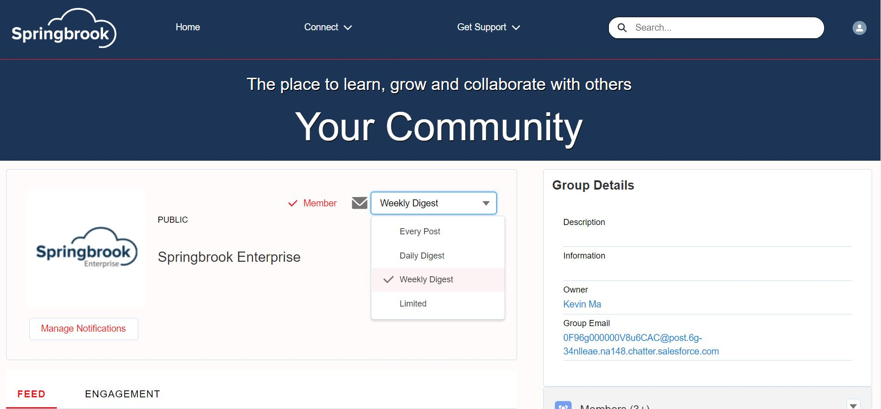

Slide 28
Questions?

Slide 29
1099R

Slide 30
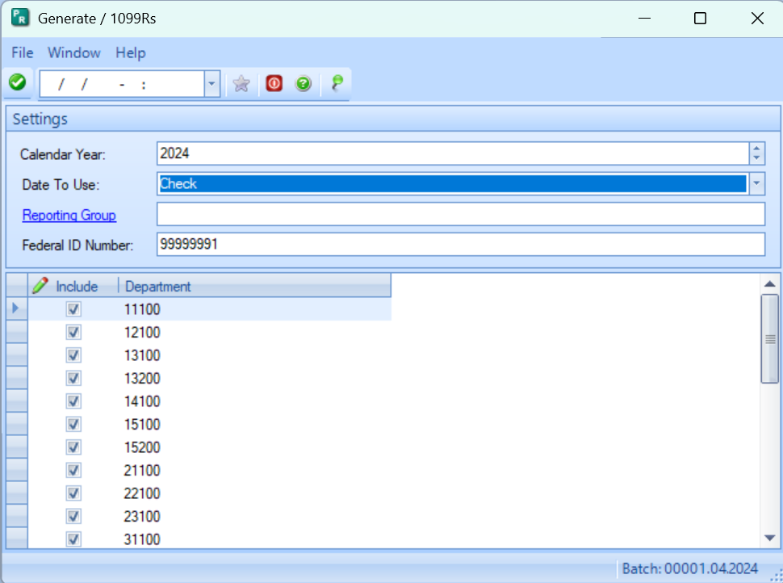
1099R
1099Rs are generated in Payroll.
The batch number and year does not matter for the process.
Data is stored in Payroll typically with a different department than standard Payroll entries.
May also use Reporting Groups.
Select the proper Calendar Year and Department(s).
Change the Federal ID Number if necessary.

Slide 31
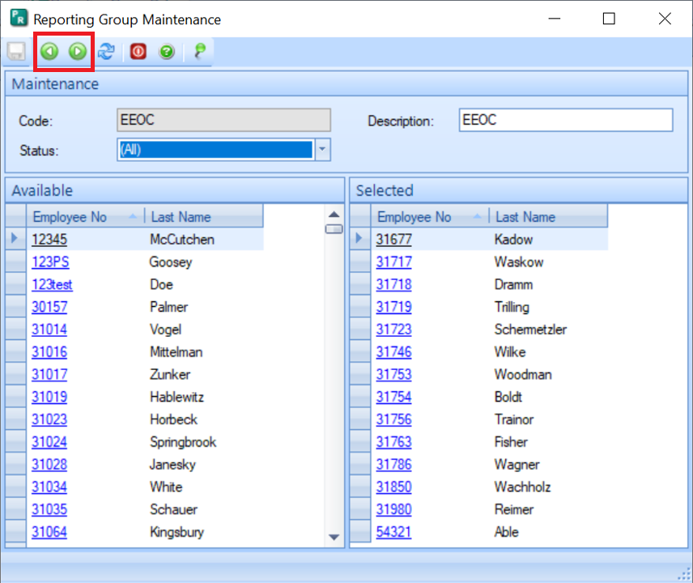
Reporting Group
PR >Maintenance > Report Group
Highlight an employee in the Available field and click the Add Employee icon. This will add the selected employee to the Selected field.
Highlight an employee in the Selected field and click the Remove Employee icon to move the selected employee from the Selected to the Available field.

Slide 32
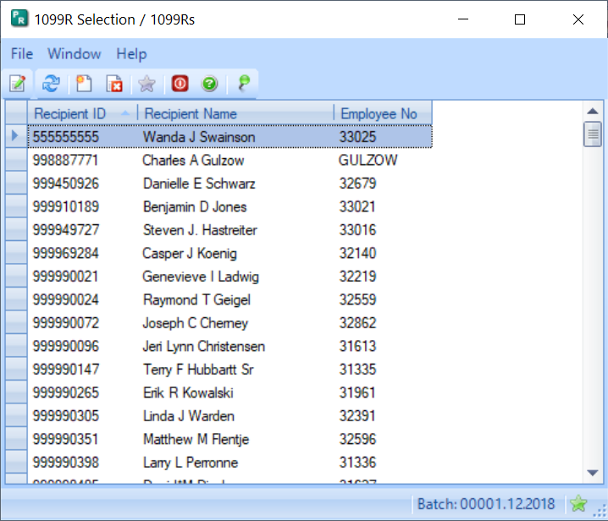
Edit
A list of all employees with history will display.
Open employees using the modify button or double click on the employee.

Slide 33
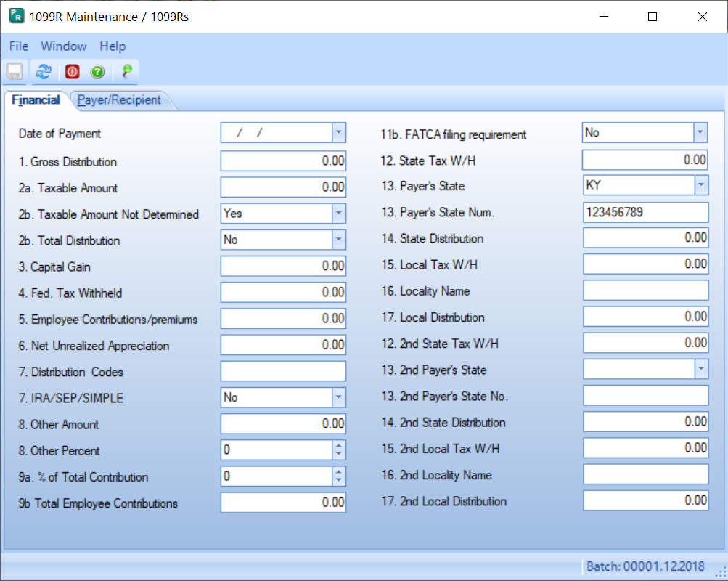
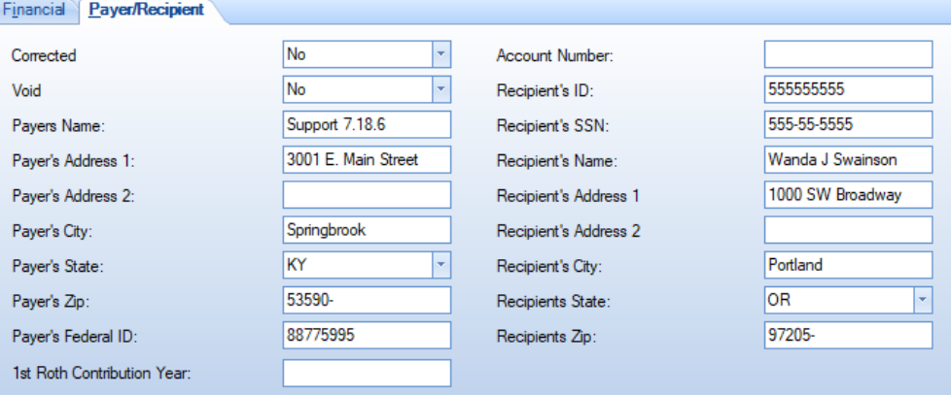
Edit
Two tabs of data will display.
Modify any information needed. Gross Distribution and any withholding amounts should be filled in.
Payee information is on the second tab.
Taxable amount will NOT be determined or filled out.

Slide 34
Proof List
Will provide you information on the 1099 forms.
Will not show recipient information.

Slide 35
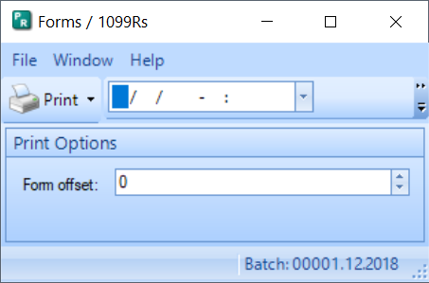
Print
Set the offset or change after printing and comparing to the forms.
Line up similar to 1099 forms.

Slide 36
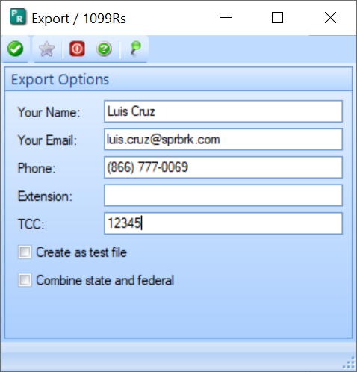
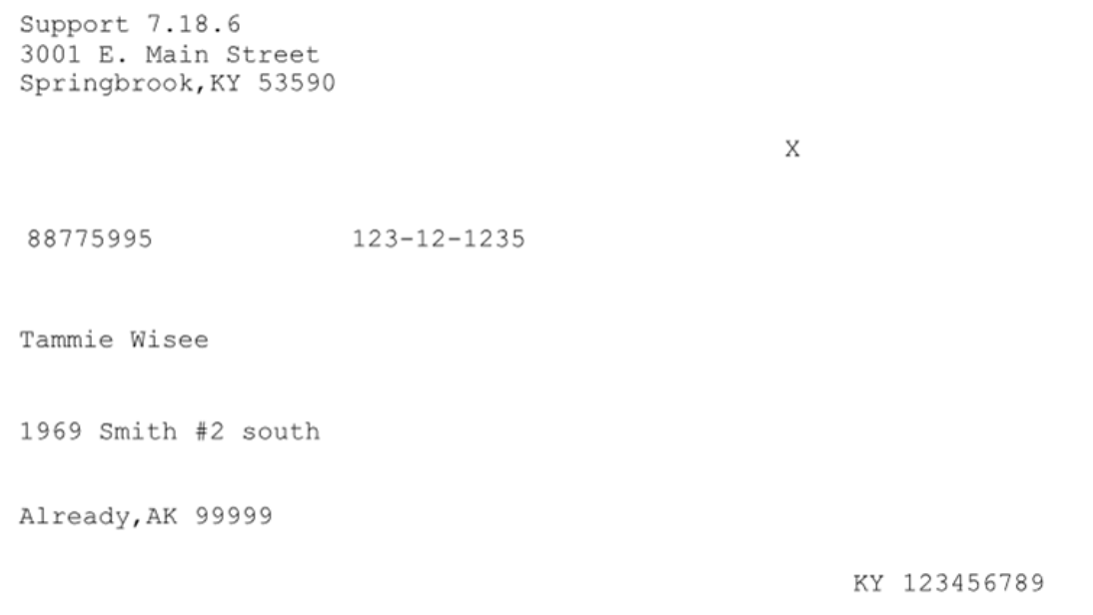
Export
Send forms on paper or export.
If you export you will upload the file to the FIRE or IRIS system just like 1099’s.

Slide 37
Questions?

Slide 38
Primary Colours
Secondary Colours
Thank you!
Luis.cruz@sprbrk.com

