Slide 1
Primary Colours
Secondary Colours
Springbrook – Getting Ready for Affordable Care Act

Slide 2
Agenda
Resources and Access to ACA Database Solution
Database tips
Data Extraction and preparation
Batch overview – Details on December 10th webinar
Importing
Electronic filing

Slide 3
Resources
Springbrook Community – Affordable Care Act Playbook.
https://enterprisehelp.springbrooksoftware.com/m/107867
IRS.gov – 1095 instructions
https://www.irs.gov/pub/irs-dft/i109495c--dft.pdf
Affordable Care Act Information Returns (AIR) Program page
https://www.irs.gov/e-file-providers/air/affordable-care-act-information-return-air-program
Notes:
12/14 DT Updated instructions link for 1095 to 2022 draft

Slide 4
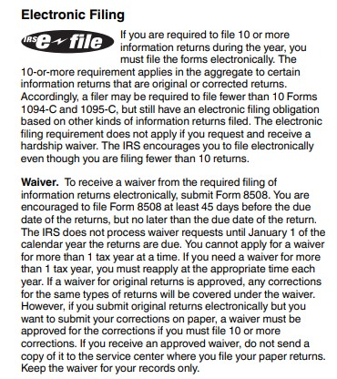
Due Dates for Filing
The electronic-filing threshold for information returns has been decreased to 10 or more returns.
1095-C forms are due to the employee by no later than March 3, 2025.
Filings to the IRS are due by February 28, 2025, if filing on paper and March 31, 2025, if filing electronically.
Notes:
12/14 DT – Put the due dates for filing on this slide. Didn’t seem like a good fit with the provisioning stuff where it was origianlly

Slide 5
Access to Springbrook ACA Solution
For on-premise hosted Springbrook Enterprise (v7), KVS, and SoftRight customers, access to the solution will be provided. If you did not already receive the email, it should arrive by EOD 12/9.
User was created based on last year's usage and email communication will be sent directly to users from cheryl.weimer@sprbrk.com with subject: “Springbrook 2024 Affordable Care Act reporting is ready.”
A preceding email was sent on 12/2 from cheryl.weimer@sprbrk.com with subject: “Springbrook 2024 Affordable Care Act Solution.” If you didn’t get this email, please contact Support.
Cloud hosted customers have access already to the ACA solution in their Springbrook Cloud Payroll. The Software ID was switched to the filing year of 2024 so prior years can no longer be submitted.
Notes:
12/14 DT – Updated provision dates section. I’m not sure why the due dates for filing are on this slide

Slide 6
To log in to your Springbrook ACA Database
To access your Springbrook ACA solution, go to https://portal.springbrooksoftware.com/ and follow the steps below to get logged in. Please also refer to our user login guide for more information.
Enter your email address and then select the continue option.
At the Enter Your Password step select the Forgot Password? option.
In the Forgot Your Password? step you should see the email address you entered earlier. Select the Continue option.
Open your email and look for an email from no-reply@springbrooksoftware.com. In the email select the link to set the initial password for your user.
Enter your desired password. You will be provided with guidance on requirements. Once your password is established select the option to return to login.
On return to login log in with your email address and password.
You will be presented with an option to select your multi-factor-authentication (MFA) method - Authenticator App, Security Key, Phone (voice call or text message). Select the method you would like to use and then follow the steps to configure it.
On successfully establishing MFA you will be logged into our application portal, and you will see the option to launch either our Springbrook Enterprise or Cirrus application interface.

Slide 7
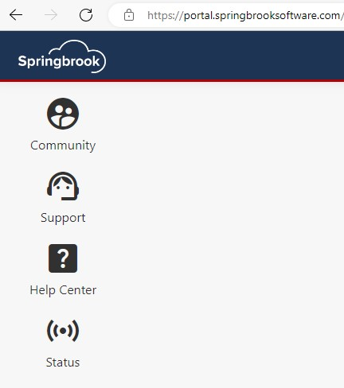
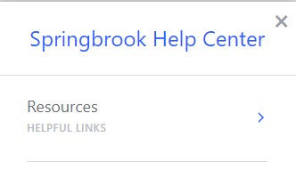
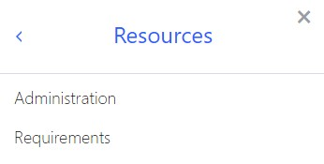
The Portal
Once logged into the portal, you can select either Enterprise or Cirrus to launch that database platform to create your ACA batch.
Once logged into the portal, you can go to Help Center > Resources > Administration for troubleshooting help or go to Requirements for our Hardware and Software Requirements.

Slide 8
To use your Springbrook ACA Database
Please note the following regarding using the Springbrook Enterprise (v7) and Cirrus application interfaces:
Springbrook Enterprise
Requires ClickOnce to be enabled for the browser. The current version of Edge has it enabled by default, for other browsers you will need to add an extension. Internet Explorer is no longer supported.
Has specific workstation requirements that must be met (OS, .NET version, WebView2 component installed...). Please see our Hardware & Software Requirements for more information.
If you are having issues launching Springbrook Enterprise, please refer to our troubleshooting guide https://help.sprbrk.com/PDF/LoginHelp.pdf.
Cirrus:
Fully browser based and can be used from all modern browsers (Safari, Chrome, Mozilla, Edge, etc.).

Slide 9
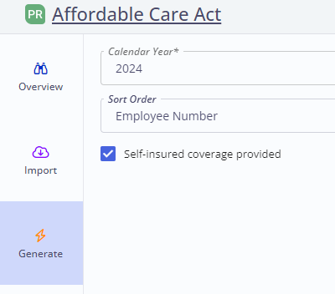
Cirrus platform is available for all users
Cirrus is ready to use for processing your ACA batch if you choose to use this platform instead of Springbrook Enterprise. Both options are included in our solution.
Cirrus has some enhancements to the ACA batch process:
If a current Cloud customer, you can use the Generate step and the Self-Insured toggle will now add the employee automatically to the dependent field when checked. If you are a provisioned client, the Generate step is not available to you.
This Self-Insured toggle will also pull dependents into the batch from HR (if applicable) when checked.

Slide 10
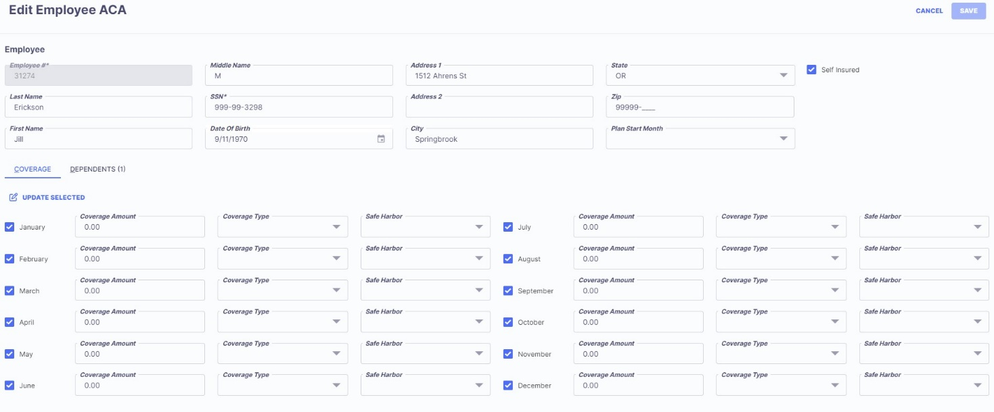
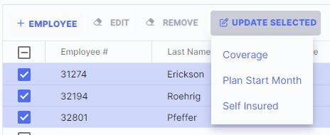
Cirrus Enhancements
Cirrus Edit Employees enhancements:
Grid views on Edit Employee step are formatted to allow users to edit an employee’s information, coverage, and dependents all from one window.
You also can update multiple/bulk employees at once, like Enterprise, using the Update Selected option.

Slide 11
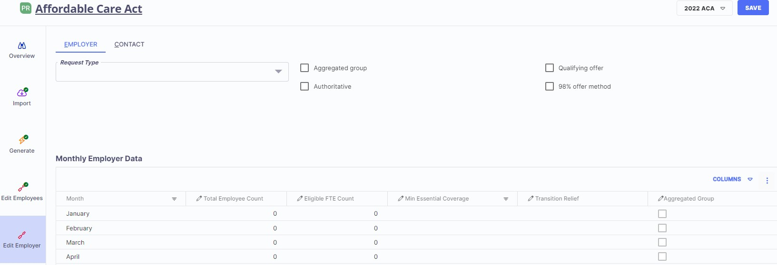
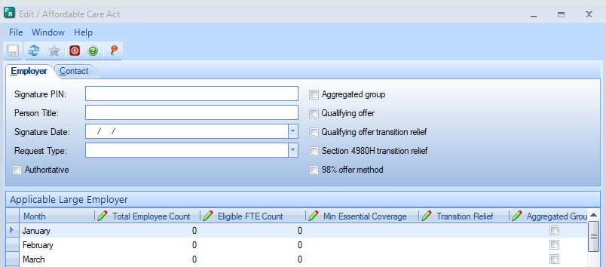
Cirrus Enhancements
Cirrus Edit Employer enhancements:
The Edit Employer step has been simplified, removing options that are no longer used by the IRS. Cirrus vs Enterprise

Slide 12
System view when you first launch Cirrus or Enterprise as a Provisioned client
If your system does not look like this, please contact Support.
You should see Payroll and the Affordable Care Act batch Process.

Slide 13
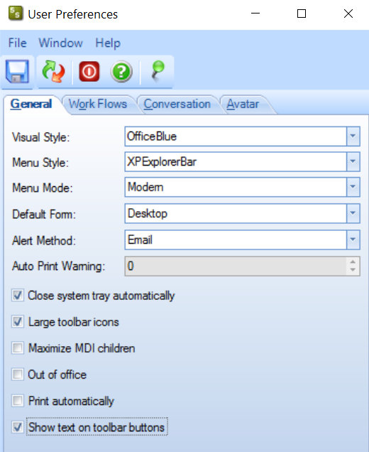
Change User Preferences
This is not required but can help you with processing in Enterprise.
At the top of the window click on User Settings then Preferences.
The defaults will work but clicking on “Show text on toolbar” button will make it easier to know what the buttons do in various windows.
Just click in the box
Save the changes.

Slide 14
Change User Preferences
After saving there will be descriptions next to each button (icon) in the various windows.
The Affordable Care Act Edit Employee window contains many buttons, so it helps to have them defined.
Cirrus automatically shows the text next to each button (icon) in the various windows.

Slide 15
Job Viewer – Scheduled
All jobs (Import, Proof List, Forms, Export) will display in the job viewer. You will also see them in Tasks or Reports but everything (even reports run previously) can easily be found in Scheduled/Jobs Viewer.
Click on the Scheduled/Jobs Viewer button at the top of the palette.
Check the toggle on the right to “Show jobs that didn’t complete due to an error.” This will help you when importing and will display any jobs that need to be reviewed.

Slide 16
Job Viewer – Scheduled
This box toggled will help you when importing files in case there is an error.
Window will default to today’s date, but any jobs run can be reviewed by changing the dates.

Slide 17
You will need to extract data from your Payroll solution to use our cloud hosted ACA solution.
Detailed information on extracting data from your Payroll solution can be found here:
KVS https://kvshelp.springbrooksoftware.com/a/1365180-affordable-care-act-kvs
SoftRight https://kvshelp.springbrooksoftware.com/a/1493947-affordable-care-act-softright
Springbrook Enterprise https://enterprisehelp.springbrooksoftware.com/a/1493575-aca-data-acquisition-for-springbrook-enterprise-clients
In Springbrook you can also use Payroll Query by Example (recommended for v7.18).

Slide 18
Getting your data ready to Import
Use the Data Extraction Utility for your software (Springbrook, KVS or SoftRight)
If using Springbrook, review the document on Community to walk you through the process.
Review data to remove disallowed characters. Do not import SSN dashes. The system will add these for you.
Open file in Notepad.
Use the Replace option under Edit to search for disallowed characters.
Type in what you want to replace with. If removing a period or similar character, leave the ‘Replace With’ field BLANK. Don’t add extra spaces.

Slide 19
Disallowed Characters
Characters the IRS does not allow in their electronic filing are not allowed in the Affordable Care Act process.
/ (common in address ½)
‘ apostrophe
. Period
# (common in address – replace with No)
“ double quotes
< less than
> Greater than
& Ampersand

Slide 20
Disallowed Characters
Disallowed characters will import but create a Review in the Job Viewer.
If you are filing on paper (have less than 10 forms) you may be able to file with the disallowed characters, but electronic filings will be rejected.
Springbrook recommends not using disallowed characters in any filings.
If you are an existing Cloud Payroll customer, you can use the Generate step to bring Employees in and we have made it function so the system will remove any disallowed characters for you.

Slide 21
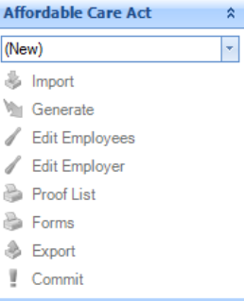
Batch Processing
In Springbrook, many processes are done in batches. The Affordable Care Act process is a batch process.
Click the down arrows, or the Create New Batch if in Cirrus, to open the Affordable Care Act process.
Click on the (New) button twice in Enterprise to set up a new batch. If the New Batch window does NOT open, use the enter key on your keyboard.
A new window will open.

Slide 22
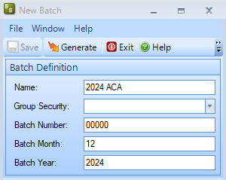
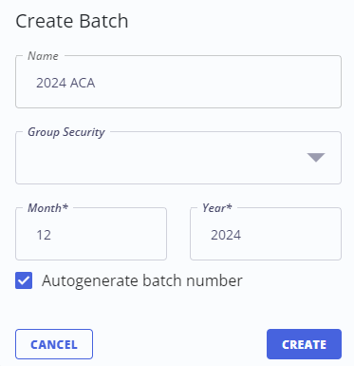
Batch Processing
Type in a name for your batch (not required but helpful).
Click on the Generate button or Create to create a batch. The window will close when you save.
You are now ready to process the individual batch steps.
You can have multiple batches open at the same time.

Slide 23
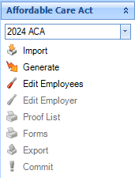
Batch Processing - Steps
Each step in the batch works separately. The next step cannot be accessed until the step before it is completed.
Import – Will allow external data to be imported into the batch.
Generate – ONLY used by existing Cloud Payroll clients.
Edit Employees – This is where most of your work will be done.
Edit Employer – Contains employer information required in the export.

Slide 24
Batch Processing – Steps (cont.)
Proof List – Required to run but may not be very useful to you.
Forms – This step generates the forms and adds required information to the export step.
Export – Creates the file to upload to the IRS AIR system.
Commit – Not used and not recommended. All this does is delete the batch information.

Slide 25
Prepare to Import
The import process brings in data from CSV spreadsheets and adds the information to the Edit Employees window.
Extract the data from your existing system (Springbrook, KVS or SoftRight.)
The data must be in a CSV format and contain the defined number of columns/fields. Check to make sure the Date of Birth column is there.
When reviewing exported data from your system consider using Notepad to remove/replace disallowed characters.
Remember opening a CSV formatted file will delete leading zeros in any column.
MOST IMPORTANT in zip codes and Social Security numbers!!!! These fields must contain accurate data.

Slide 26
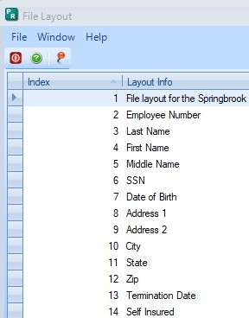
Import Formats – Employee File
File formats are at the top of the Import window.
All columns must have data or space. Must have 13 columns (A-M).
The last column (Self Insured) must be True if reporting dependents and False if you are not reporting dependents.

Slide 27
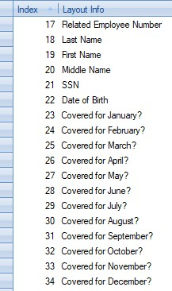
Import Formats – Dependent file
Only used if your agency is considered Self-Insured and must report Dependents.
If importing Dependents make sure the “Self-Insured” field in the Employee file is marked True.
Employee number must match the Employee file.
Must have 18 columns (A-R).
Must have all the covered months marked either True or False. Yes/No will not import.

Slide 28
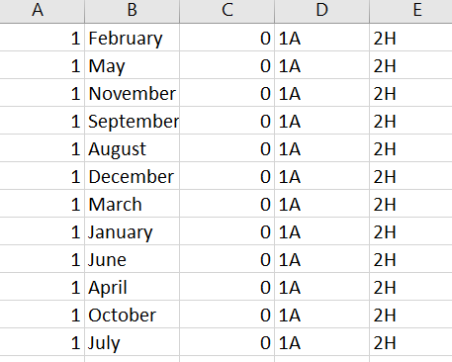
Import Formats – Coverage File
Coverages can be added directly into the application, so this is not commonly used.
If you decide to import Coverage, the Month must be spelled out.
Coverage amount is the amount the employee pays (per IRS instructions).
These records must be a separate line for each month.

Slide 29
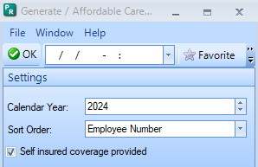
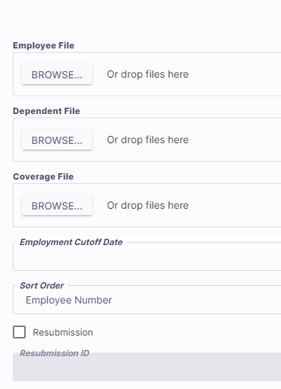
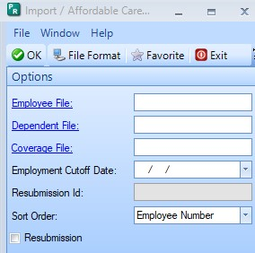
Import or Generate
Generate is only available to existing Cloud Payroll customers. All others will use the Import process or manual entry.
Employment Cutoff Date field is used to limit the employees included in the batch to only those that were employed AFTER the specified date.
For example, if you are processing ACA reports for 2024, you would enter 01/01/2024 in this field to filter out employees that left the organization earlier. Can be left blank if you have included only the employees you want imported on the file.
Cirrus Import step has fields in a more user-friendly order.

Slide 30
Edit Employees
This window contains all the employee reporting information.
In Enterprise, the + in the left margin will open each employee monthly information. Clicking it again will close the employee information.
In Cirrus, select the employee and click the Edit to view information.

Slide 31
Edit Employer window
Information on the Edit Employer window is only used for Electronic filing.
If filing on paper (less than 10 forms), you can add the Contact info and save without additional information.
This Edit Employer window will be discussed in the ACA Webinar on December 10th, 2024. You can register for this on our website https://springbrooksoftware.com/springbrook-training/

Slide 32
FORMS
Forms print in the order selected during the Import or Generate process.
The forms print landscape on two double-sided pages.
NOTE FOR EXISTING CLOUD PAYROLL CLIENTS ON FORMS: If you still have open Affordable Care Act batches from a prior year the forms may not print properly for those batches. Current batch information only will print properly.

Slide 33
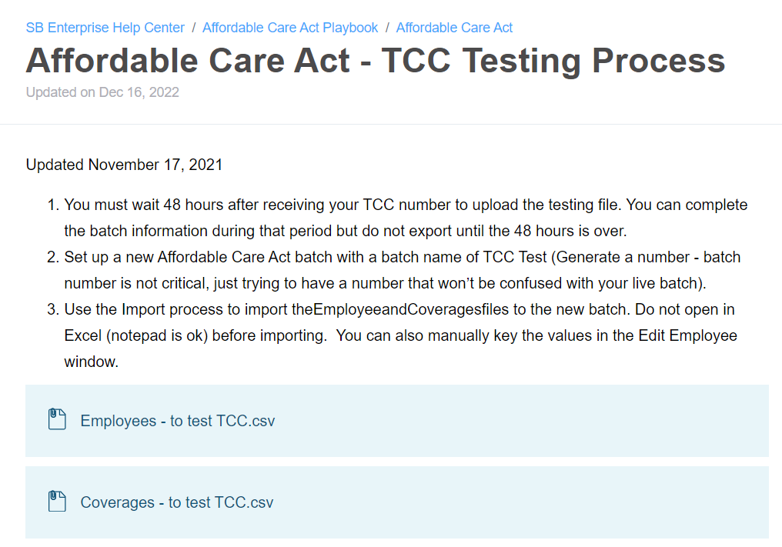
Electronic Reporting
Cannot electronically file until January 2025.
If you have not previously filed electronically, or you are new to taking over this process, you need to get a TCC number from the IRS and test the TCC number.
Instructions in the Playbook.
https://enterprisehelp.springbrooksoftware.com/a/1365167-affordable-care-act-tcc-testing-process
TCC test files can be imported now if needed, these test files are provided in the Playbook on Community.

Slide 34
Go to AIR and scroll down to the Apply button if you do not already have a TCC.
Test files can be imported to a separate batch in Springbrook but must contain test information. You cannot test your TCC number using your live file/real information. Use the test info we provide in the Playbook.
ACA TCC is different to 1099 TCC.
Refer to the testing instructions in the Affordable Care Act Playbook for information. https://enterprisehelp.springbrooksoftware.com/a/1365167-affordable-care-act-tcc-testing-process
For new TCC users/new filers: It can take a couple weeks to get a TCC, test it, and have it moved from test to production status. This must happen before you file your live file.

Slide 35
Questions?

Slide 36
Primary Colours
Secondary Colours
Thank you!

