Slide 1
Primary Colours
Secondary Colours
Springbrook – Affordable Care Act Processing

Slide 2
Agenda
Resources
Batch Setup and overview
Data Extraction and preparation
Edit Employees entry
Edit Employer entry
Filing

Slide 3
Resources
Springbrook Community – Affordable Care Act Playbook
https://enterprisehelp.springbrooksoftware.com/a/1348282-aca-processing
Community website – https://success.springbrooksoftware.com
IRS.gov – 1095 instructions
https://www.irs.gov/pub/irs-pdf/i109495c.pdf
Affordable Care Act Information Returns (AIR) Program page
https://www.irs.gov/e-file-providers/air/affordable-care-act-information-return-air-program

Slide 4
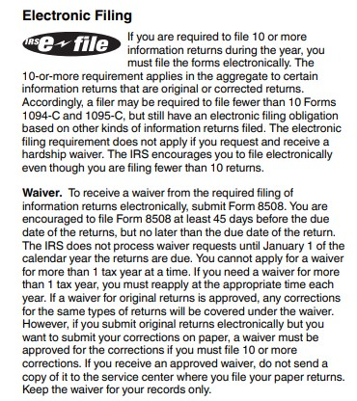
Dates For Reference
What’s New: The electronic-filing threshold for information returns has been decreased to 10 or more returns.
Due date for furnishing statements to employees - March 3, 2025.
Due date for filing on paper (if less than 10 forms) – February 28, 2025.
Due date for filing electronically – March 31, 2025.
Provision date for on-premise Springbrook, KVS or SoftRight clients – email was sent on . Email was sent by cheryl.weimer@sprbrk.com .
Software ID has been updated in our system, but you cannot file to AIR until January 2025.

Slide 5
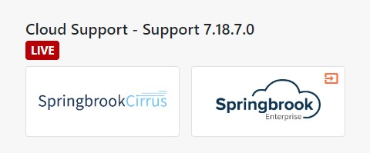
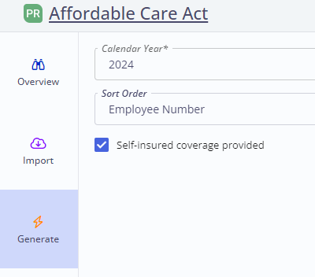
Cirrus platform is available for all users
Cirrus is available to use for processing your ACA batch if you choose to use this platform instead of Springbrook Enterprise. Both options are included in our solution.
You can work in Cirrus and then switch to Enterprise and all your saved work will be there. It is your choice which platform you use.
Cirrus has some enhancements to the ACA batch process. (Release date 12/12/24) 1094/1095B is only available in Cirrus. 1094/1095C is available in either platform. Most file C.
Cirrus is fully browser based and can be used from all modern browsers (Safari, Chrome, Mozilla, Edge, etc.).

Slide 6
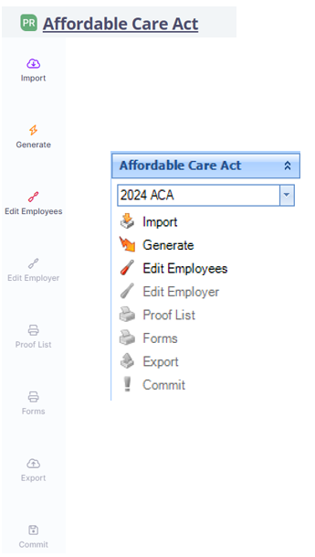
Affordable Care Act batch process
Import or Generate
Edit Employees
Edit Employer
Proof List
Forms
Export
Commit – never needed just deletes information.

Slide 7
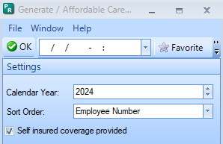
Generate – Only Available for Existing Cloud Payroll clients
Check Security if you do not have it on your menu.
Select reporting year – Will default to the current fiscal year. You are reporting for 2024. The system will only bring in employees that are active in 2024.
Sort Order – This will determine the order the forms are printed. Will be helpful if you want to match up forms to W2s to mail.
Mark Self-Insured coverage if you need to report dependents.
Cirrus only: The generate will bring in dependents in HR if selected and will not if this toggle is not marked.
If self-insured reporting is needed you can import dependents from a file if they are not in your HR system.

Slide 8
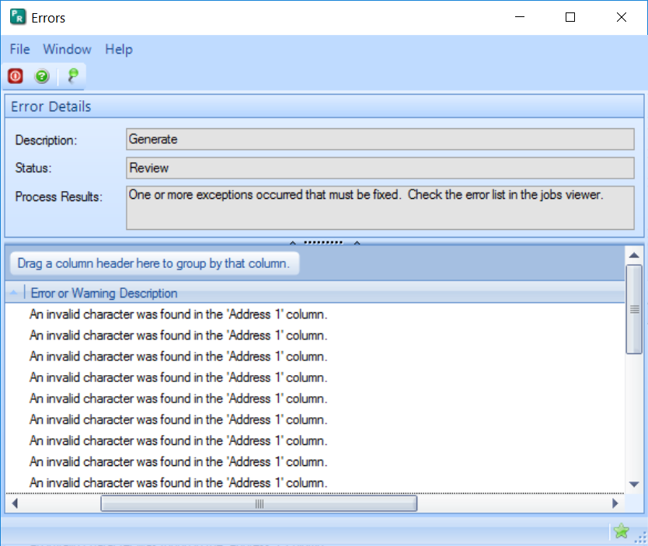
Generate – Existing Cloud Payroll clients only for Enterprise and Cirrus
We corrected an issue that could cause an error for review if an employee name or address includes a disallowed character. You will still get this review message now, but the disallowed characters will be removed for you. You will not need to go in and remove the disallowed from the Edit Employees step.
You can keep the review list and modify your employee records to remove disallowed characters.

Slide 9
Data extraction
Springbrook data extraction will export employees and dependents (if dependents are stored in HR module) only.
Employee file – Review for disallowed characters and double spaces. SSNs should not have dashes. Springbrook will add those.
Dependent file - If you are not reporting as “self insured” you will not need the dependent file. If you need the file, make sure to review it for disallowed characters (except / from birth dates).
Remember opening CSV files in Excel will remove all leading zeros. Critical for zip codes and Social Security numbers.

Slide 10
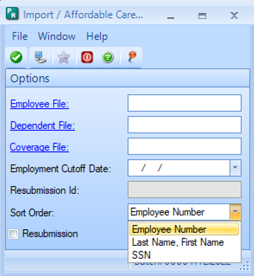
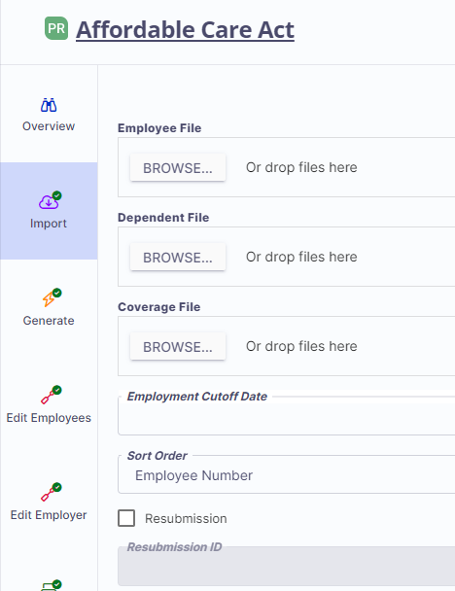
Import Files
Open Import step in the batch. This can be done after employees are generated.
Select the file(s) to import.
Select the sort order you want the forms printed in.
Important if matching to W2’s to mail.
Click Check mark or Submit button to import.
NOTE: If you import an Employee File after the Generate step was run, the new file will replace all employees currently in the batch.

Slide 11
Tips for Dependent and Coverage Import
Dependent and Coverage files can be imported after Employees are imported. If Employees are already imported/generated in the batch, then the system will more easily match the Related Employee Number from the Dependent and Coverage files to the correct Employee.
You cannot import additional employees without overriding ALL employees and information in the batch.

Slide 12
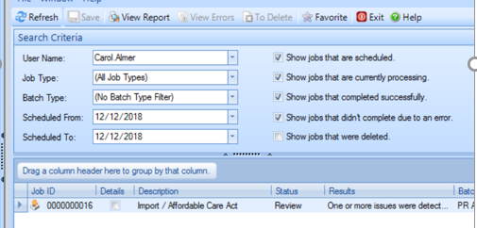
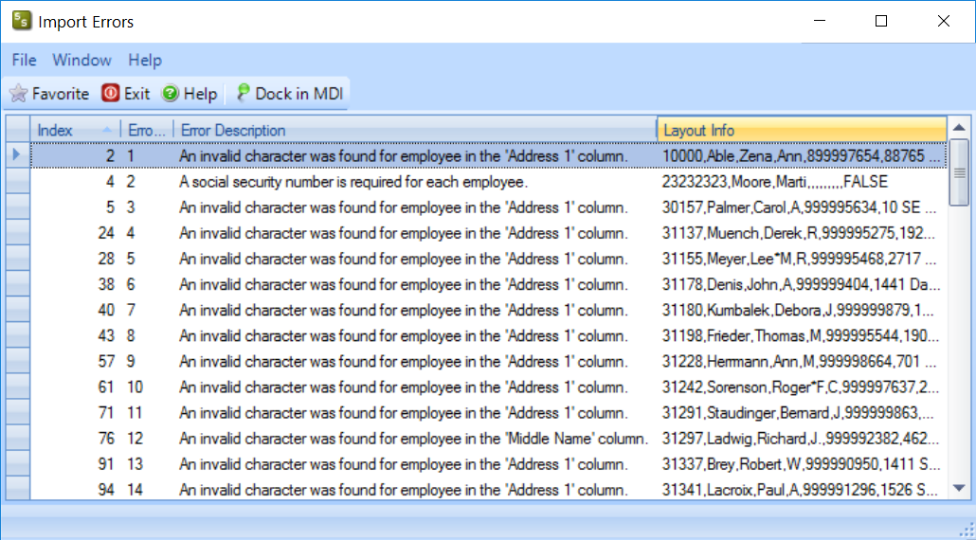
Review/Errors
If the status is “Review” there are errors in the files so the import did not include all information.
Click on the View Report icon at the top or double click on the item below. The errors will display.
Common error last year was missing the Date of Birth column in Employee file.

Slide 13
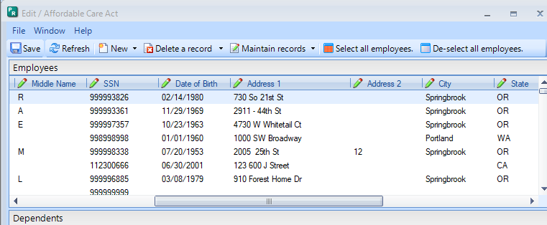
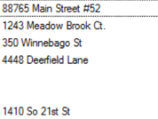
Review/Errors
In almost every case the employee has been imported into the batch with invalid data.
NOTE: If you import additional employee files, ALL employees in the batch will be overridden. Not the case if you import dependents or coverages.

Slide 14
Affordable Care Act batch process
Import or Generate
Edit Employees
Edit Employer
Proof List
Forms
Export
Commit – never needed just deletes information.

Slide 15
Edit Employees
Tip: It works well to go through your batch and delete any employees that you do not need to report before doing anything else.
This window contains all the employee reporting information.
In Enterprise, the + in the left margin will open each employee monthly information. Clicking it again will close the employee information.
In Cirrus, select the employee and click the Edit to view information.

Slide 16
Enterprise - Edit Employee Functions
Save – Will enable when changes are keyed.
Refresh - Not often used, will restore information on the window.
New – Use drop-down arrow to choose if you add a new employee or dependent.
Delete a record – Use drop-down to delete an employee or a dependent.
Maintain records – Select Coverage record or Plan Period record to maintain all selected.
Select all employees – Will mark the selected box for all employees. Works with the Maintain records, Copy and delete functions.

Slide 17
Enterprise - Edit Employee Functions (cont.)
De-select all employees – Removed the selected toggles for all employees.
Copy Employee to Dependents – Copies each employee to dependents. ONLY used if Self Insured is toggled. (Enterprise ONLY)
Favorites (only used if you are using dashboard)
Exit – Will close the window without saving any entries
Help – Will open Springbrook help.
Dock in MDI/Undock – Will enclose the window in the MDI and make it smaller.

Slide 18
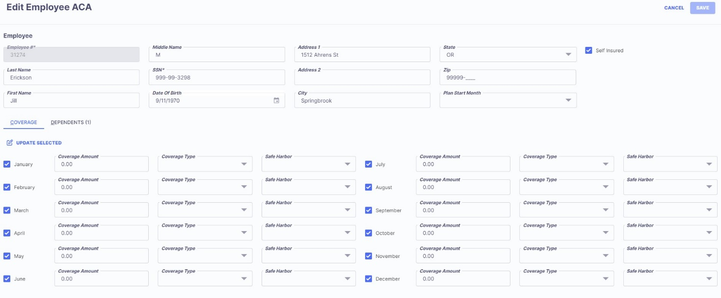
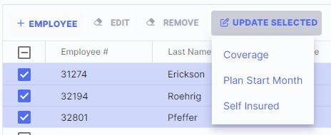
Cirrus – Edit Employee Functions
Grid views on Edit Employee step are formatted to allow users to edit an employee’s information, coverage, and dependents all from one window.
You also can update multiple/bulk employees at once, like Enterprise, using the Update Selected option.

Slide 19
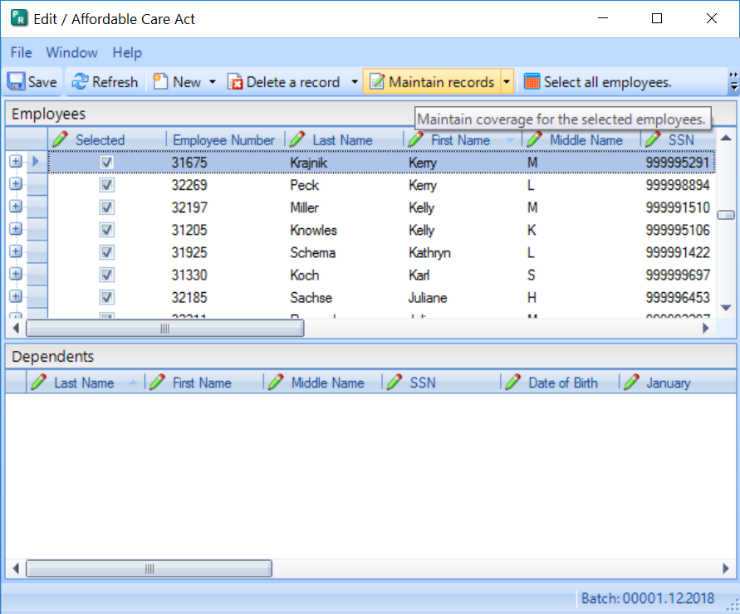
Edit Employees – Recommended process
If doing entry within Springbrook the quickest way to process the batch is to change all employees to the most common values, then modify the ones that are different (such as employees that did not work the full year).
Click the Select all employees button – This will mark all employees selected. If you want, you can remove any employees desired by clicking in the selected box manually.
SAVE OFTEN to avoid losing work.

Slide 20
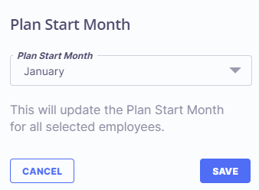
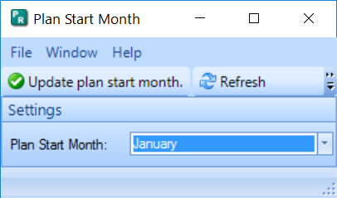
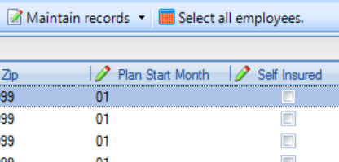
Edit Employees – Recommended Process
Use Maintain Records > Plan Period Maintenance (Update Selected > Plan Start Month in Cirrus) – Adds the plan start month to each employee. This is the month your agency plan starts, not the employee specific information.
Often this is the same for all employees.
This is required by the IRS for 2024 reporting.
Will display the month number.

Slide 21
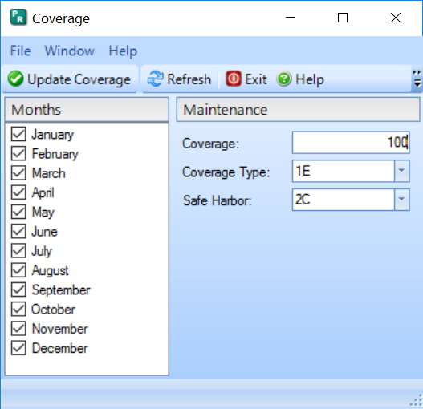
Edit Employees – Update Coverage
Use the Maintain records > Coverage maintenance (Update Selected > Coverage in Cirrus) – Adds the coverage and safe harbor codes to months specified.
Tip: Click on January and use the Ctrl+A to highlight all months. Once highlighted you can use the space bar to check all the months. Cirrus has a select all toggle.
Type in the Coverage dollars, coverage type and safe harbor codes. Refer 1094/95 instructions for code help. Springbrook does not give advice on the codes to use.

Slide 22
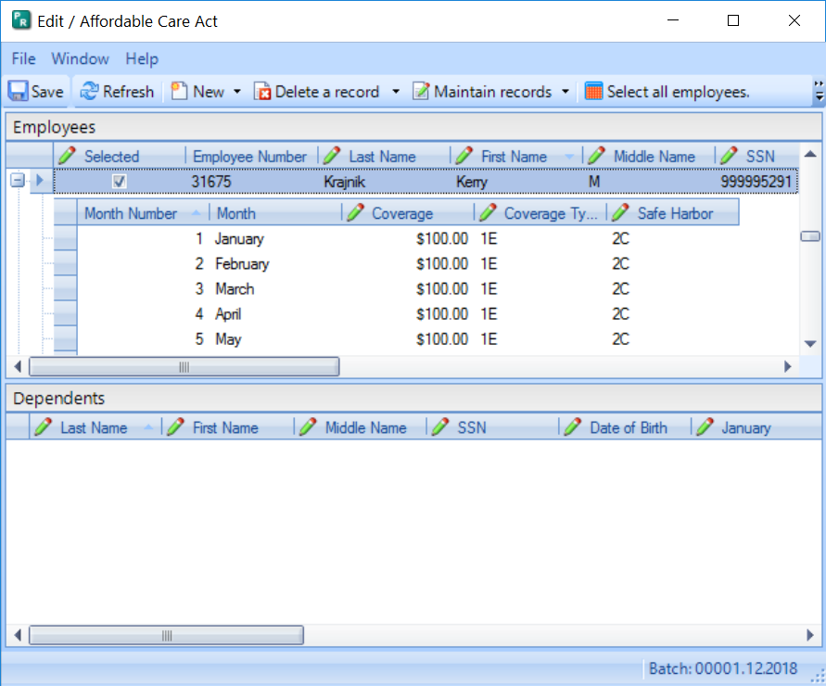
Edit Employees – Update Coverage
Each selected employee will now show the coverage updated.
The save button will also enable in Enterprise. Save often.
The window may take a while to save, please be patient.
You will need to reopen the Edit Employees window after saving in Enterprise.

Slide 23
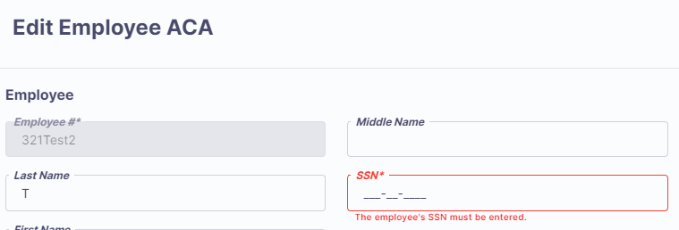
Edit Employees – Save errors
If the window does not close or save in a minute or so, check for errors.
The system will identify errors with red font.
If you are missing an SSN, it will not be allowed to save and must be fixed.

Slide 24
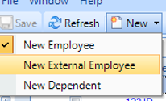
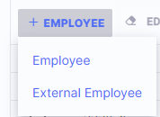
Edit Employees – Existing Payroll Cloud clients only
Non-employees can be added to the batch through New > New External Employee (+Employee > External Employee in Cirrus) to add a non-employee (typically for retirees).
This is not true for On-prem, KVS or SoftRight clients: Import your non-employees instead with your employee file during the import process.
When selected, a new blank line will be added to the grid in Enterprise and a new employee window opens in Cirrus. All information can be added.
Employee numbers cannot be duplicated or changed after saving.

Slide 25
Edit Employees – Entry tips
NEVER have more than one User working in the Edit Employees window at the same time. One person working will lose their work as soon as the other Saves.
The provision databases for On-Prem, KVS and SoftRight clients are usually set up with one single user in their ACA database. Login information can be shared and used by multiple users, or Support can add an additional user for you if needed. Contact Support if you need an additional user.

Slide 26
Items to Edit and Check
Sort by the following columns to make sure there are no blanks that will fail when uploading to the IRS AIR system.
First & Last Name – no spaces at the beginning.
SSN – review to make sure all appear to be 9 digits. Dashes should not be seen.
Address & City – no spaces at the beginning.
Zip – must be either 5 or 9 digits. Anything else will fail.

Slide 27
Add Dependents - Enterprise
Dependents can be either keyed or imported.
Dependents are ONLY included if you need to report as self-insured. You can get that information from your insurance carrier.
If manually adding dependents, click on the employee and use the New Dependent option.
A dependent line will open in the Dependents field.
Be certain to check all the months the dependent was covered.
Enterprise interface only: Use the Copy Employee to dependents to copy employee information to the dependent field.
TIP: Do not add dependents (even employee) if the employee waived coverage. It will throw errors in the transmission to AIR.

Slide 28
Add Dependents - Cirrus
Dependents can be either keyed or imported.
Dependents are ONLY included if you need to report as self-insured. You can get that information from your insurance carrier.
If manually adding dependents, click on the Dependents tab
A dependent line will open in the Dependents field.
Be certain to check all the months the dependent was covered.
Cirrus interface only: the employee will auto populate in the Dependent field when checking Self-Insured toggle for the employee.
TIP: Do not add dependents (even employee) if the employee waived coverage. It will throw errors in the transmission to AIR.

Slide 29
Saving tips
Save often as you are manually updating Affordable Care Act records. It takes time but will help you if you make a mistake. You can exit without saving and only have some edits to do again.
If the window doesn’t close in a couple minutes max, scroll through the employees to see if there is an error.
Errors will be indicated by red font (and exclamation mark in Enterprise).

Slide 30
Affordable Care Act batch process
Import or Generate
Edit Employees
Edit Employer
Proof List
Forms
Export
Commit – never needed just deletes information.

Slide 31
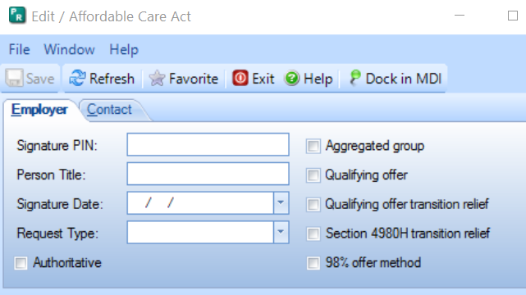
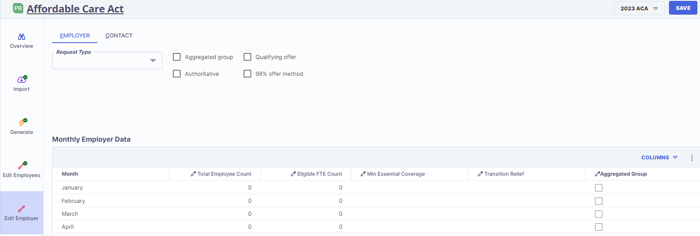
Edit Employer
Edit Employer information is CRITICAL if you are going to file electronically. If you are filing on paper (unlikely), you can simply fill out the Contact tab information.
Some fields not required for 2024. Cirrus enhancement has these unnecessary options removed. Leave the following blank in Enterprise:
Signature PIN
Person Title
Signature Date

Slide 32
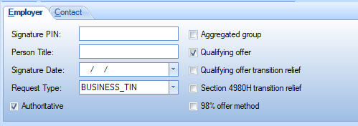
Employer tab
Request Type – Generally Business TIN. Must be indicated.
Authoritative – Must check unless part of an Aggregated group.
Aggregate group - must not toggle unless you are part of an Aggregated group.
Qualifying offer – Most clients check this.
98% offer method
98% offer method

Slide 33
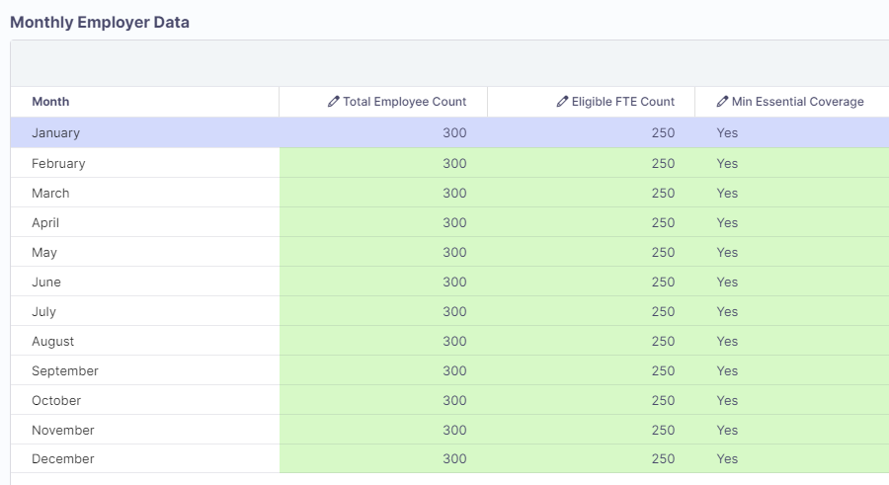
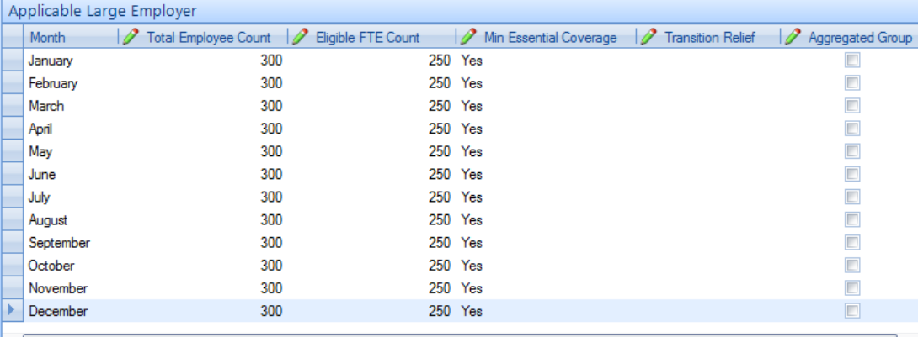
Applicable Large Employer/Monthly Employer Data
This information must be included if filing electronically as Authoritative for the ALE member.
Total Employee Count – This is for the total number of employees per month.
Eligible FTE Count – Number of employees eligible for insurance. MUST BE LESS THAN OR EQUAL TO THE TOTAL EMPLOYEE COUNT FOR THE MONTH.
Min Essential Coverage – Yes – must answer for each month.
Transition Relief – Not used for 2024.
Aggregate Group – If applicable.

Slide 34
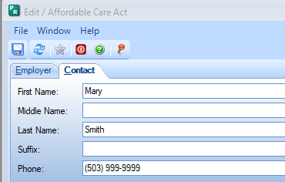
Contact tab
Complete the First Name, Middle Name, Last Name, Suffix (if applicable) and Phone for the person with the TCC number. This is the person responsible for answering any questions from the IRS. (see page 7 of IRS instructions)
NOTE: Make sure there are no spaces after the typed information to avoid filing errors with the AIR system.

Slide 35
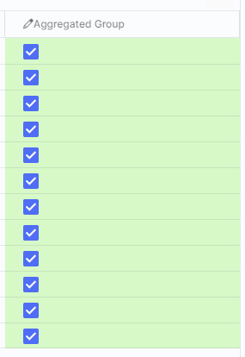
Aggregated Group - Uncommon
If Aggregated Group is toggled on the General tab two additional tabs will appear.
You will know if you are part of an Aggregated Group based on how you file W2 information.
If you don’t know you are likely not part of an Aggregated Group.
Cirrus interface only: if checked, the column in Monthly Employer data will auto check also.

Slide 36
Government Entity tab
ONLY used if the organization is part of an aggregate group. Will only display if Aggregated group is checked on the Employer tab.
Enter complete address and DGE information. See page 7 of the IRS instructions.

Slide 37
Aggregated Entities tab
ONLY used if your agency is a part of an aggregate entity.
This window should include each entity that is included with your reporting and the EIN number. The entities listed here will be filing non-authoritative returns.
NOTE – The EIN names and numbers must match tax filings and are often the same as the Government entity.

Slide 38
Affordable Care Act batch process
Import or Generate
Edit Employees
Edit Employer
Proof List
Forms
Export
Commit – never needed just deletes information.

Slide 39
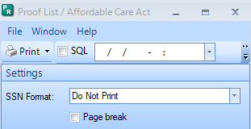
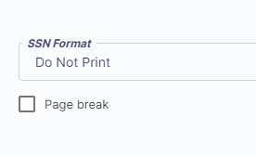
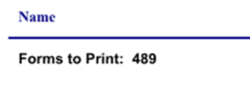
Proof List
Run the Proof List – This is a required step but you don’t have to use the report. We have added the employee count to the last page of the report to give you the information for your Export step.
Page break will print one employee to a page.
Forms to Print on the last page will give you the number to report in the export step.

Slide 40
Affordable Care Act batch process
Import or Generate
Edit Employees
Edit Employer
Proof List
Forms
Export
Commit – never needed just deletes information.

Slide 41
Forms
Many users find review of the information is easier by reviewing the Forms rather than the Proof List.
Forms will print in the order selected during the Import or Generate process.
We have also added an additional page to print for employees that have more dependents than can fit on the standard form. This will only be important for clients that are considered self-insured and report dependents.

Slide 42
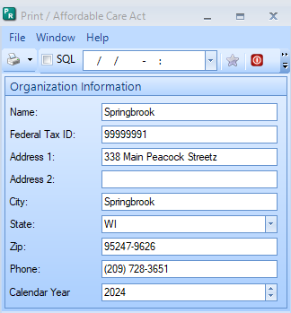
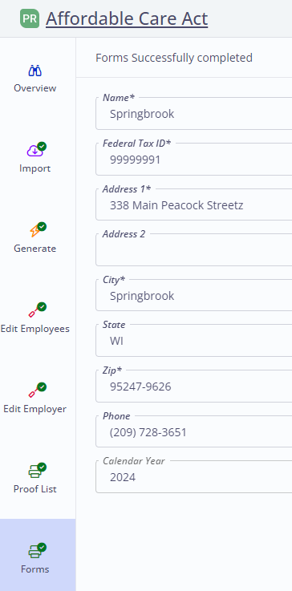
Forms
This step is where you print your employee forms.
Be sure to keep the following in mind:
Federal Tax ID – no dashes
Address – no characters
Select the Calendar (reporting) Year. Should be 2024. Cloud Payroll clients will default to fiscal year of the system and may need to be changed.
Forms will print in the order selected on the import or generate step.

Slide 43
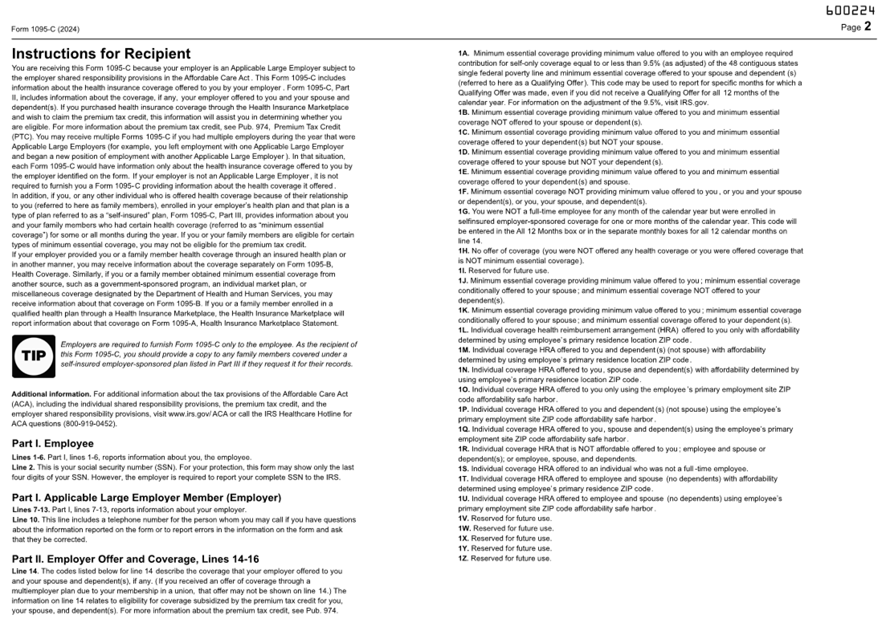
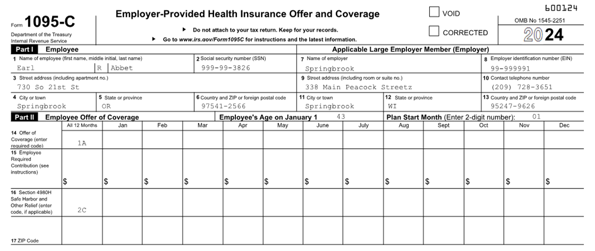
Forms print – Use a duplex printer
Page 1 Page 1 - Backside

Slide 44
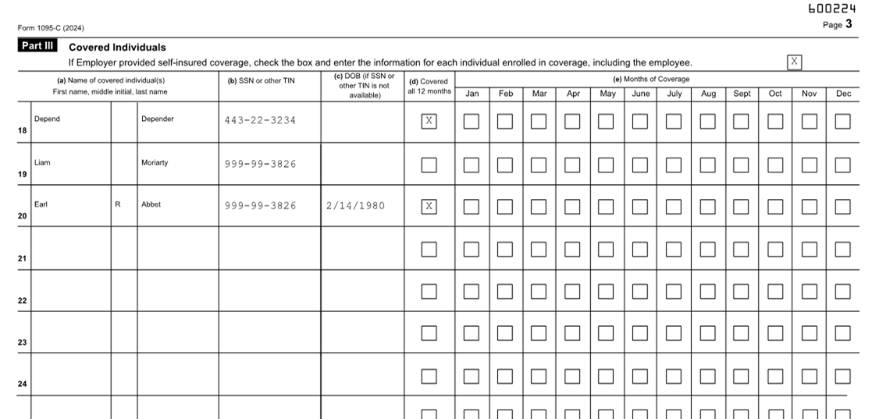
Forms print – Use a duplex printer
Page 2 Page 2 - Backside
If you report Self-Insured (dependents are included) additional pages may be printed if dependents cannot fit on the page provided.

Slide 45
IRS Filing on Paper
If you have fewer than 10 forms, you are allowed to file on paper to the IRS.
Complete the 1094C transmittal form from the IRS website.
Contains the same information as the Edit Employer window does in the ACA process.
https://www.irs.gov/pub/irs-pdf/f1094c.pdf
Copy BOTH sides of the 1095C forms to submit.
IRS could send back if both sides are not included.
Mail forms to the IRS.

Slide 46
Affordable Care Act batch process
Import or Generate
Edit Employees
Edit Employer
Proof List
Forms
Export
Commit – never needed just deletes information.

Slide 47
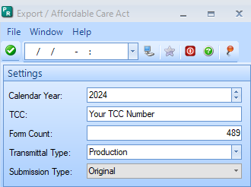
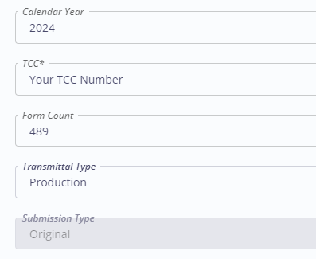
Export
Creates an Export file to upload to the IRS AIR system.
Calendar Year – Year being reported.
TCC – Your agencies Transmittal Control Code (not the same as 1099).
Form Count – Number of forms
Transmittal Type
Production – Normal selection
Test – Only used to test TCC numbers
Submission Type
Will only be available if the Import Step was marked as a Resubmission.
Resubmission (uncommon)
Correction – Used to correct data if you received “Accepted with Errors” letter

Slide 48
Export – Cirrus Only
NEW: Cirrus is adding the choice to export either 1094/1095C or 1094/1095B.
Speak with your tax advisor if you are unsure whether B or C applies to your organization.
Springbrook Support cannot advise you which to file.
This should be available after 12/12/2024 release. No action is required by you to get this feature once it is released.

Slide 49
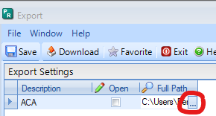
Export
Find your Export files in the Jobs Viewer and double click to open.
In Cirrus, it will automatically download a zip file. Open file and “Extract All” to save in a folder you have assigned for keeping your files organized.
In Enterprise, you will need to click on the ‘…’ to choose where to save your files. Click Save.
Login to the IRS AIR system and transmit your 1094C (or 1094B if applicable) and Manifest files.
You do NOT need to Commit your batch. Recommend leaving it there in the event you need to go back and Edit again.

Slide 50
Parting Words…
If your transmission is Rejected or Accepted with Errors, download and save the error message and email it to Support@sprbrk.com to create a case. We will help you interpret the errors to fix your file.
If you still need to file or correct a prior year, check with the IRS first on their expectations. Our software is equipped for 2024 filing year with 2024 identification only. This may not be acceptable for prior years.
Do not commit or delete your batch. Save all documentation (exported files, transmission confirmations, receipt IDs, transmission errors etc.) in organized folders so they can be referred to, as necessary.

Slide 51
Questions?

Slide 52
Primary Colours
Secondary Colours
Thank you!

