Slide 1
Primary Colours
Secondary Colours
Springbrook – W2 Processing
Enterprise and Cirrus

Slide 2
Agenda
IRS information
W2 process – Generate
Exceptions
Edit
Proof List
W2
Export
Commit
7.18 and Cloud only tax table updates

Slide 3
IRS information
General Instructions for W-2
https://www.irs.gov/pub/irs-pdf/iw2w3.pdf
Accuwage
https://www.ssa.gov/employer/accuwage/index.html
Be sure to have an active BSO log in to be able to submit your W2 electronically.
Springbrook does not give legal advice so will direct you to the resources above to obtain specific code and reporting information.

Slide 4
Prepare for W2s - Balancing
Remember – If the Payroll history is correct in the system W-2’s will process without any issues or modifications.
Complete 4th quarter reports.
Do any manual check adjustments to handle items like disability pay.
Total the reported amounts for the year.
Run a deduction register (Totals only) for the year.
Check against W-2 proof list
Make sure the totals for FICA/FICAR and MEDI/MEDIR match.
MEDI will not match if you have employees that earned over $200,000.
FICA will not match if you had employees with disability pay (depending on plan).

Slide 5
W2 Process (Enterprise and Cirrus)
Generate – Brings in employee information to the batch.
Exceptions – Optional step.
Edit – Optional step.
Proof List – Summary and Detail available. Used to balance and find errors.
W2 – Prints the forms.
Export – Exports data to be uploaded.
Commit – Sends data to Employee Self Service (ESS). You must commit batch for employees to see W-2 in ESS.

Slide 6
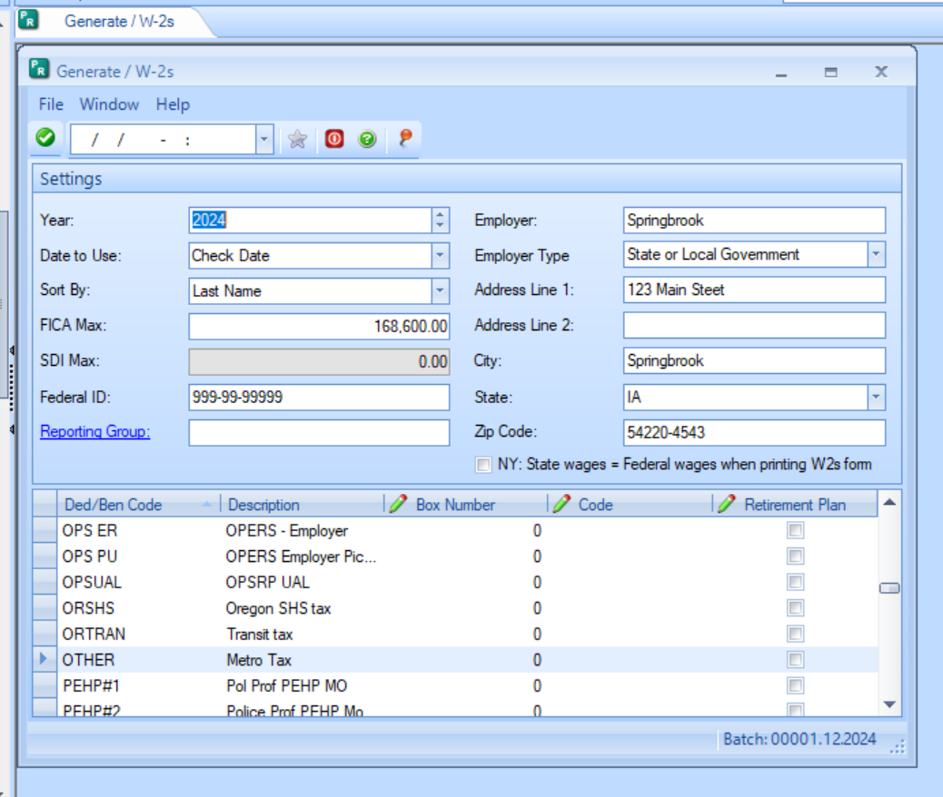

Slide 7
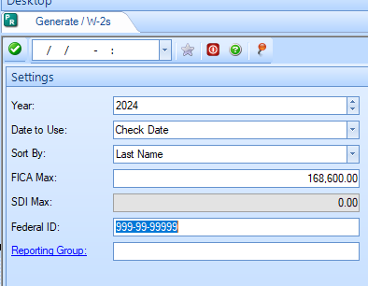
W2 Process - Generate
Select 2024 (proper year being reported).
Always use Check Date.
Select desired sort for the W2s.
Department Then Name
Employee Number
Last Name
Social Security Number
Check the FICA maximum and change if necessary.
If California, check the SDI Max.
Verify the Federal ID is correct.
Use Reporting Groups only if required.

Slide 8
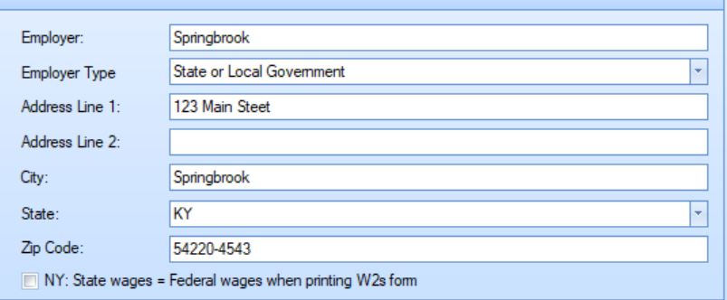
W2 Process – Generate (cont.)
Employer Name and Address come from System Setup.
Employer Type – Does not save in earlier versions.
Federal Government
Not Applicable
State or Local Government
State of Local Government tax exempt
Tax Exempt
NY: State wages = Federal wages on W-2 toggle – Used in NY. Forces the State Wages to equal the Federal wages regardless of history.

Slide 9
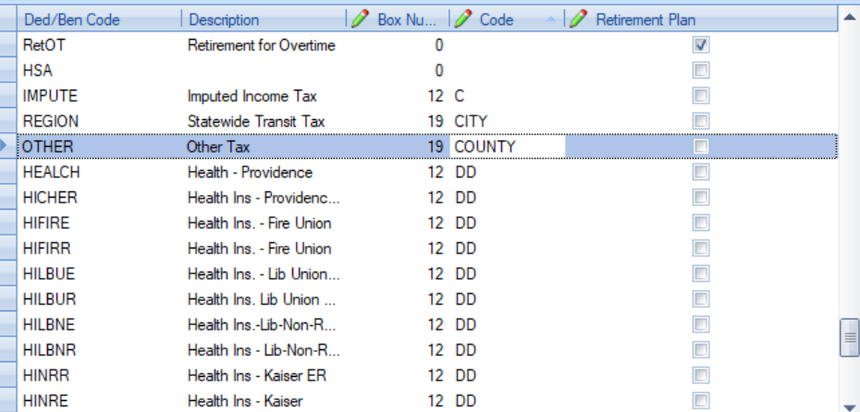
W2 Process – Generate (cont.)
Mark Retirement Plan
Mark any deductions or benefits identifying employee is in a Retirement plan.
Checks box 13 on the W2.
Fill in Box Numbers and Codes
7.15+ will create second W2s if more information than will fit in boxes 12, 14 and 19
Tip – The down arrow can make entry easier in this section of the window.

Slide 10
Generate Notes
Generate settings are not saved from year to year.
Local Taxes (boxes 18, 19, 20) on the W2 – Functionality has been added to print the description keyed in the code box if filled in. If blank the description will come from the deduction description (as room allows).
DON’T forget to toggle the Retirement Plan box for any deduction/benefit codes that should mark this box.
Reporting Groups - Used to report separate Employer tax ID numbers. Not often used unless you report multiple agencies separately. IF USED – MAKE SURE TO CHECK THE EMPLOYEES IN THE REPORTING GROUP BEFORE GENERATING!

Slide 11
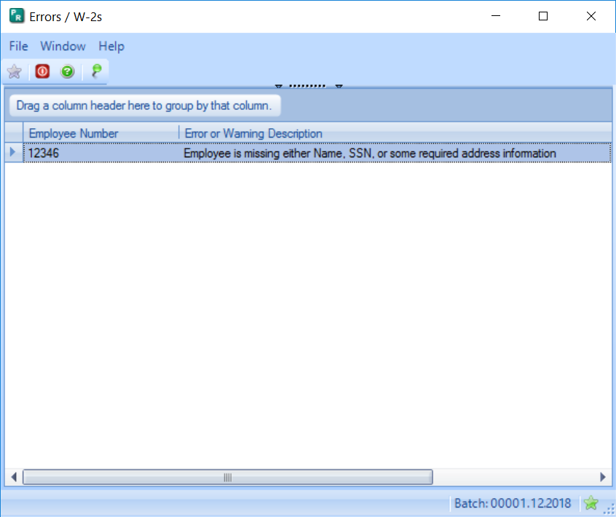
Exceptions
Exceptions include an exception if there are any negative totals brought into the process. These will reject in Accuwage.
If a Name, SSN or other required information is missing the Exceptions step will warn you.
Be sure to check for Exceptions and make any corrections even if it is not a stop error.

Slide 12
Edit Step
Do you need to edit anything?
Hopefully not any primary information.
Make sure the Retirement box checked before making any edits.
Change address information on the employee if possible.
To add a new W-2
Typically, only necessary if an employee did not have regular wages but had disability pay for the entire year.
Best Practice: Have W2 generated information match Payroll History.

Slide 13
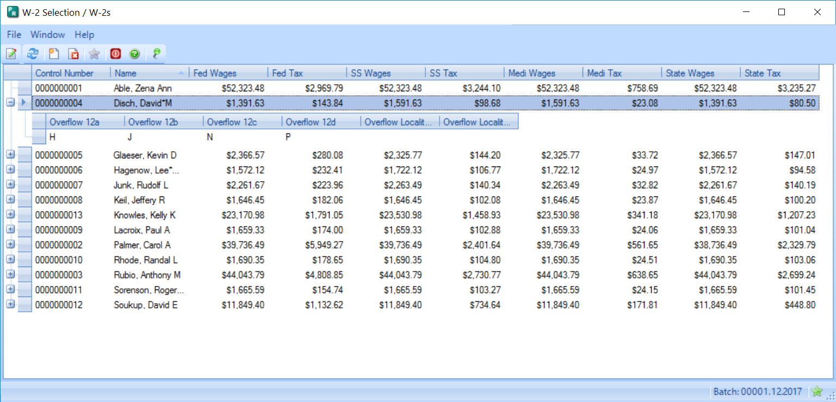
Overflow W-2s
If an employee has more than 4 items in box 12 or more than 2 in box 19 a second page will be created. This is being added for box 14. Not available in all versions.
The Plus indicates the second W-2 record. If you edit one of the records you must also edit the second record.

Slide 14
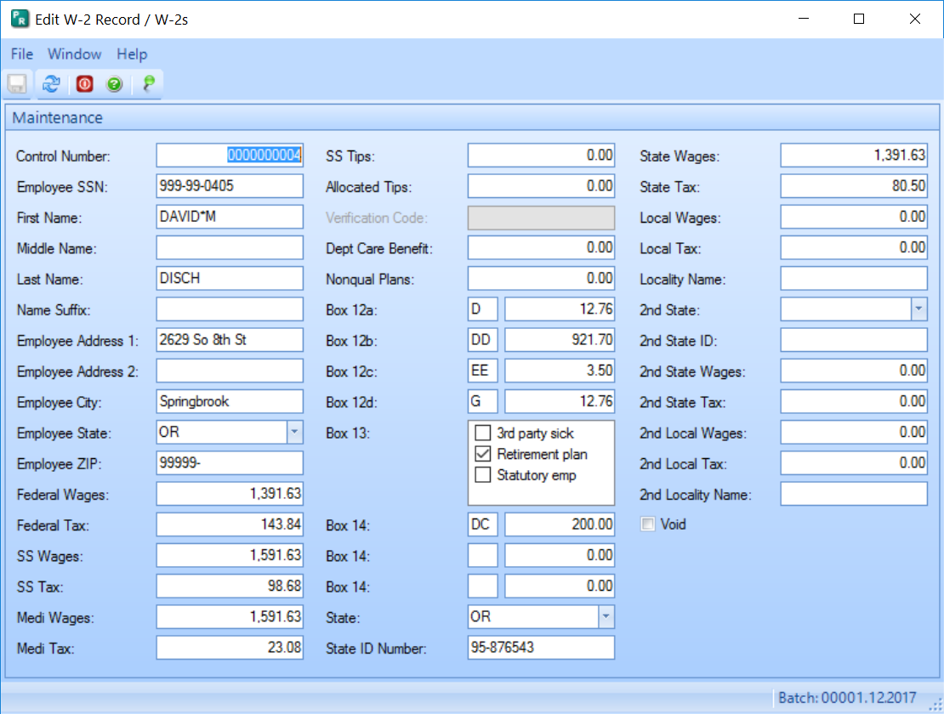
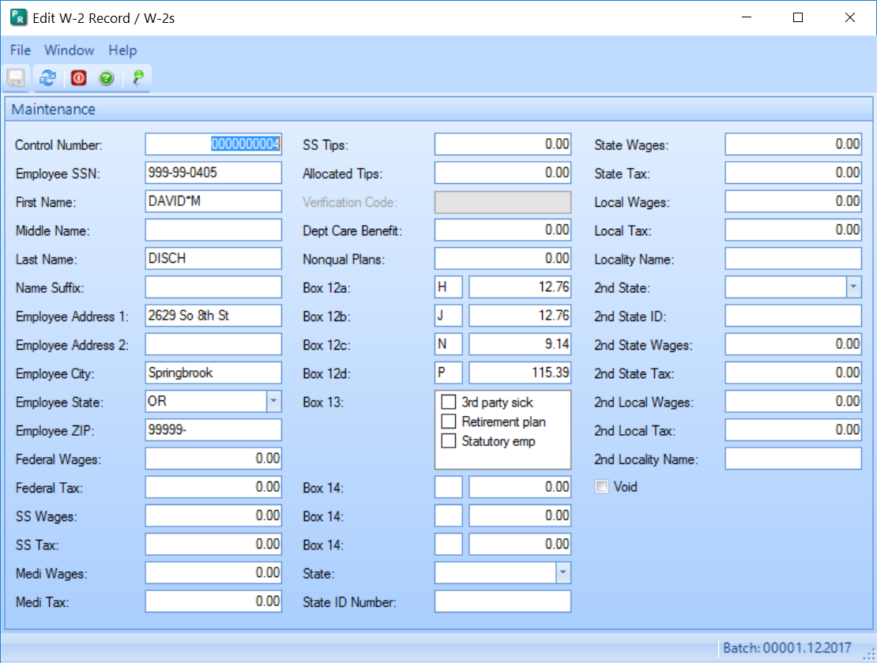

Slide 15
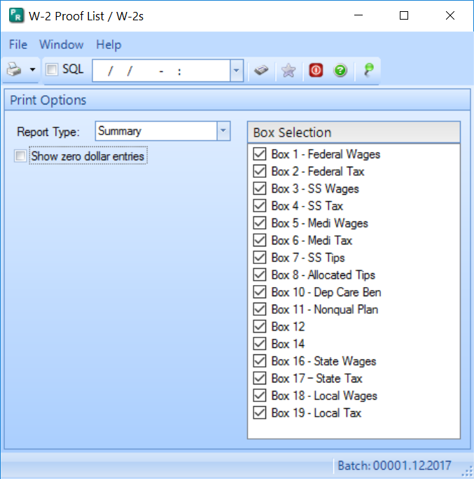
Proof List
Run Summary first. You will need to change from Detail to Summary.
Detail can be run for a single box that doesn’t balance to other reports.
Tip: Send detail to Excel as well as the deduction register (summary) or General Wage report.
If you want to save the detail, go back and run the detail for all boxes.
Only the last version run will be retained in the batch.

Slide 16
Balance W2 data to Payroll
Run a deduction register (Totals only) for the year by check date.
Check against W-2 Summary proof list.
Make sure the totals for FICA and FICAR match each other and between the reports.
If no employees exceed $200,000 , MEDI and MEDIR will match.
Balance wage totals (FED, STATE, FICA, MEDI) to the Quarterly Wage report for 4th quarter.
Use General Wage report or export (7.17+) to balance local wages.
Other has been added as a Subject Wages option to the General Wage report.

Slide 17
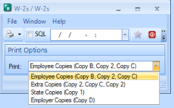
Print W2s
This step prints the W2 forms.
Employee Copies (B, 2, C)
Extra Copies (2, C, 2)
State Copies (1)
Employer Copies (D)
W2s print the entire form 3 to a page so no line-ups are needed.

Slide 18
Forms
Springbrook prints the entire front of the W-2
3 W2s to a page
Approved vendor – Some print on plain paper.
The Solv Group– 800.388.3650
https://www.thesolvgroup.com/
This link takes you to their forms page - Forms
Springbrook prints the entire front of the W-2
3 W-2’s to a page
Approved vendors
Centro – 888.828.1999
www.centroprintsolutions.com
Notable – 800.724.2870

Slide 19
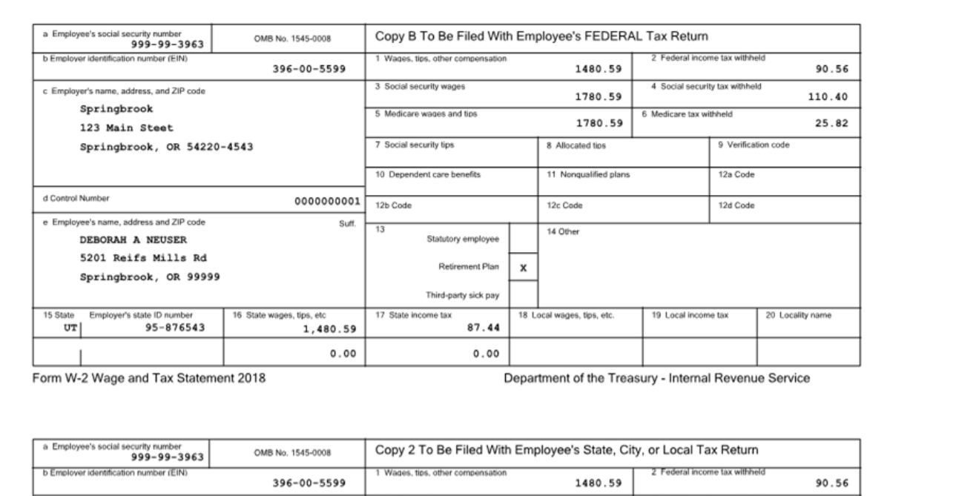

Slide 20
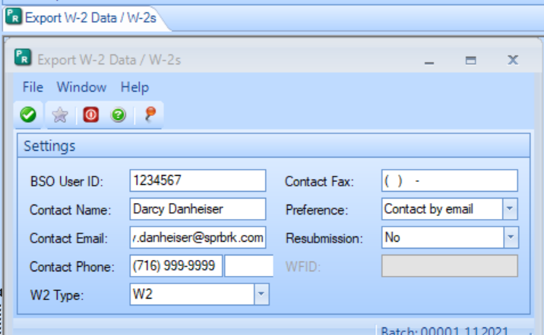
Export
Springbrook does not create a printed W3.
All reporting is done electronically.
NOTE: No record layout changes to the Federal file for 2024 reporting.

Slide 21
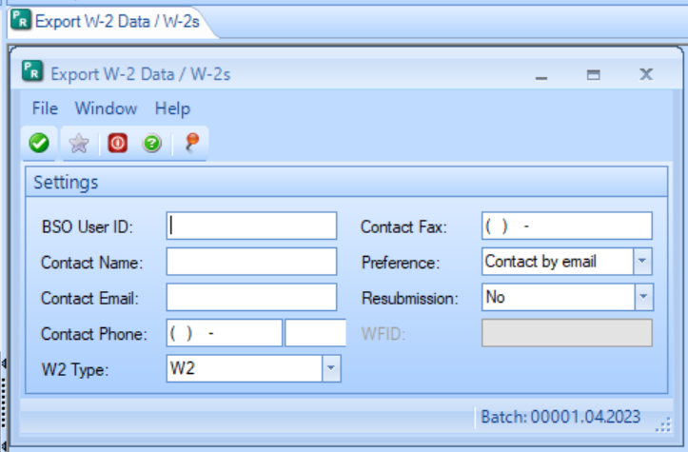
Oregon Clients ONLY
Oregon Transit Tax is reported in Box 14 for Federal Filing.
After uploading your file to Accuwage –
Generate a second W2 batch to upload to the State of Oregon.
This time, code the Oregon Transit Tax to Box 19, code ORSTT to submit to iWire.
If you made edits to your original file, you will have to make them again.
On the Export Step, say NO to Resubmission.
Run through the steps and export again to upload to OPRS.

Slide 22
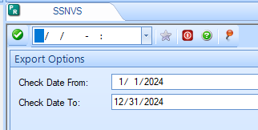
SSNVS – Social Security Number Verification Service
Checks employee names to SSNs.
Export available in both Enterprise and Cirrus: Payroll > Utilities > SSNVS.
Exports a file that can be uploaded to BSO SSNVS for Social Security Number verifications prior to sending W2s.
Link to SSNVS

Slide 23
IRS Regulations were amended last year, lowering the threshold to 10 Employees. Meaning that if you have 10 or more W-2s to issue, you must file electronically for tax year 2024.

Slide 24
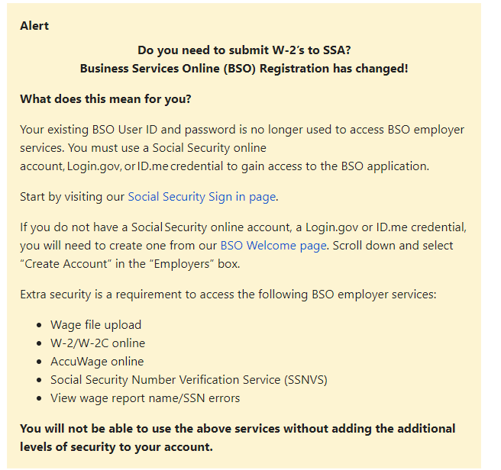
There is also a change to how an employer can access Business Services Online (BSO) in order to be able to submit W-2’s to the Social Security Administration.
Go to Business Services Online for more information and the steps to create/use a Social Security online account, Login.gov, or ID.me credential to gain access to the BSO application.
We would encourage you to create your accounts sooner rather than later as this would eliminate frustration when it comes time to file W-2s.

Slide 25
BSO – Business Services Online
Check now to make sure you can log In to BSO.
You can add additional services (SSN checking) if you need it.
https://www.ssa.gov/bso/bsowelcome.htm
Accuwage – Used to upload the W2 file export.
Must log in to BSO to get to Accuwage Online.
Instructions on the page linked below.
https://www.ssa.gov/employer/accuwage/index.html

Slide 26
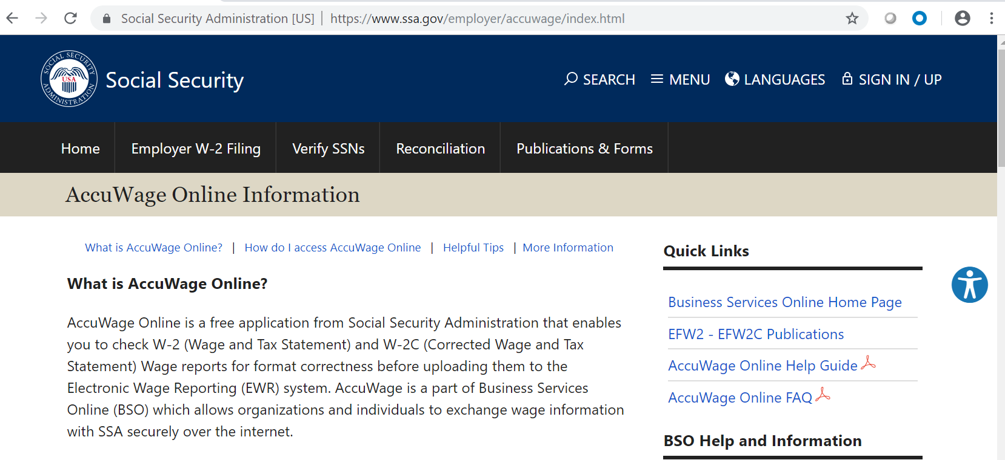
Accuwage

Slide 27
Questions so far?

Slide 28
7.18 and Cloud Only – Federal Tax Table Updates

Slide 29
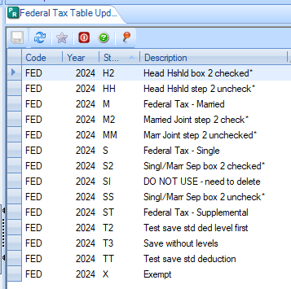
Payroll > Utilities > Federal Tax Table Update
Available for 7.18 and Cloud databases only.
If you can’t see Federal Tax Table Update – You will need to update Menu Security to access it.
Will NOT update State tax tables.
When the Year says 2025 (the next calendar year), the tables are available to update.
This window says 2024 which indicates the 2025 tax tables are not available yet.

Slide 30
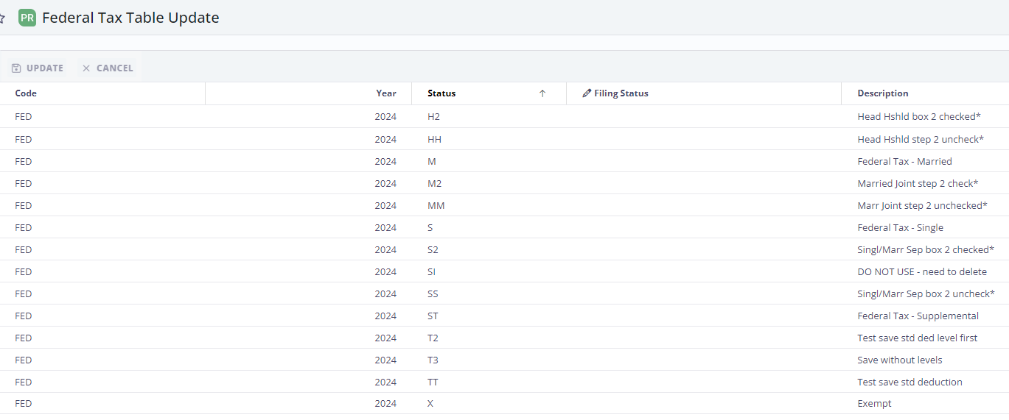
Cirrus > Payroll > Utilities > Federal Tax Table Update

Slide 31
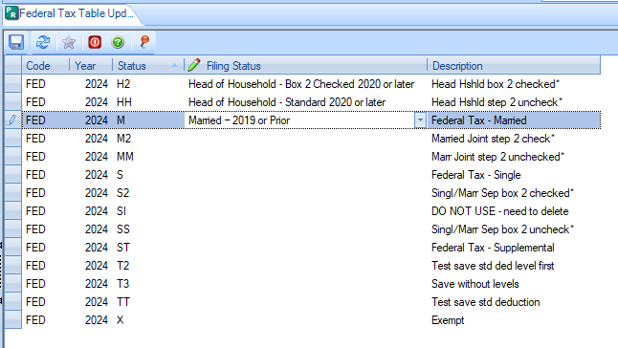
Federal Tax Table Update
Select your tax table that matches the code in the window. These are the codes and descriptions on your tax tables.
Click in the Filing Status box to display the down arrow to select the table with the update information.
Select each table to update. You can do this in several steps if desired.

Slide 32
Federal Tax Table Update
Available selections match Publication 15-T table information.
Standard indicates Box 2 is unchecked.
Single – Standard
Married Filing Jointly – Standard
Head of Household – Standard
Married Filing Separately (same as single)
Married Filing Jointly-Box 2 checked
Head of Household-Box 2 checked
Married Filing Separately – Box 2 checked

Slide 33
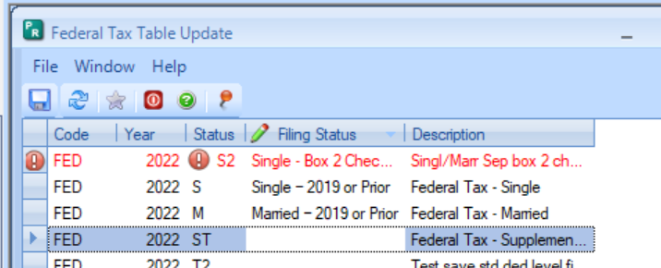
Federal Tax Table Update
Save your changes.
If any table(s) have a current revision with the date 1/1/YYYY you will get an error.
You can either change the revision date or delete the revision to resolve.
Change the error line to blank to save the rest, then check the others to resolve the issue(s).

Slide 34
Questions?

Slide 35
W2 Process in Cirrus

Slide 36
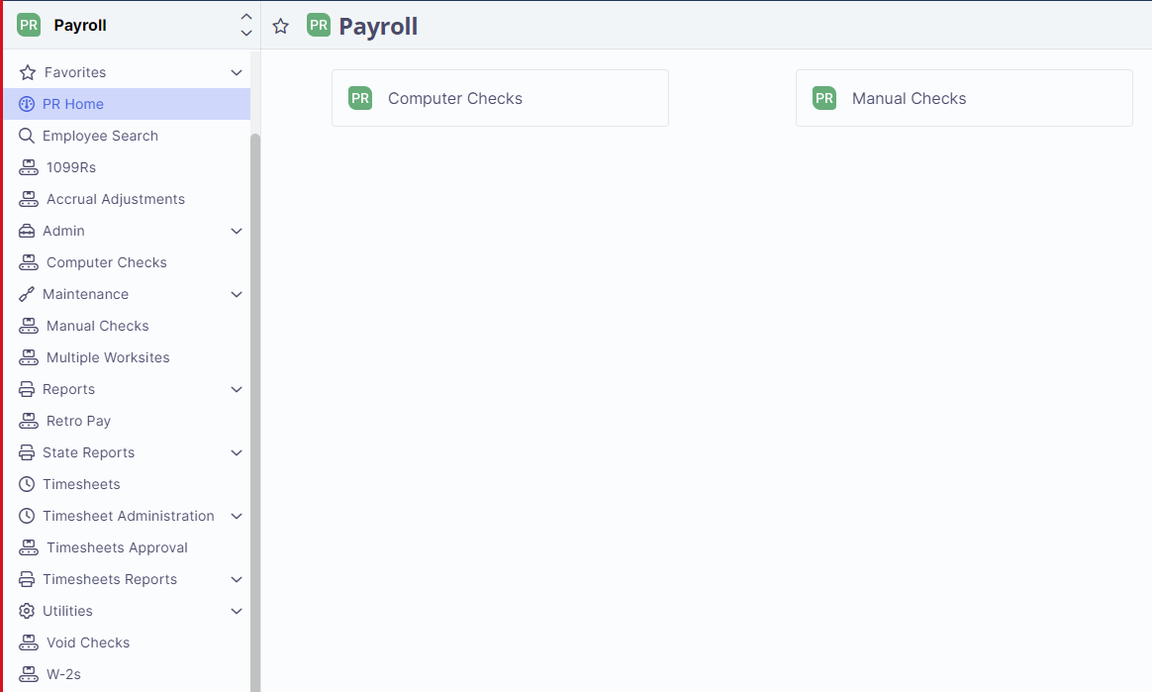
As in Enterprise, to access the W-2 process in Cirrus go to Payroll > W-2s

Slide 37
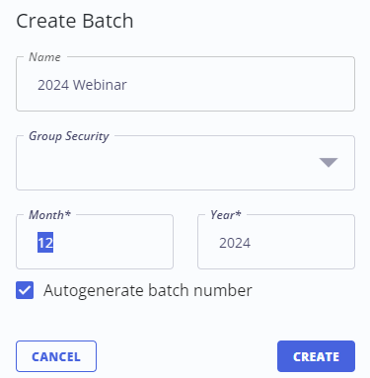
After you have clicked on W-2s, you will then have the option to Create New Batch. Click on it.
In the box that pops up, enter in the Name (if you want to name this batch it is not required) and the toggle is checked next to Autogenerate batch number. The batch month is usually 01 and the current year.
Select Create.

Slide 38
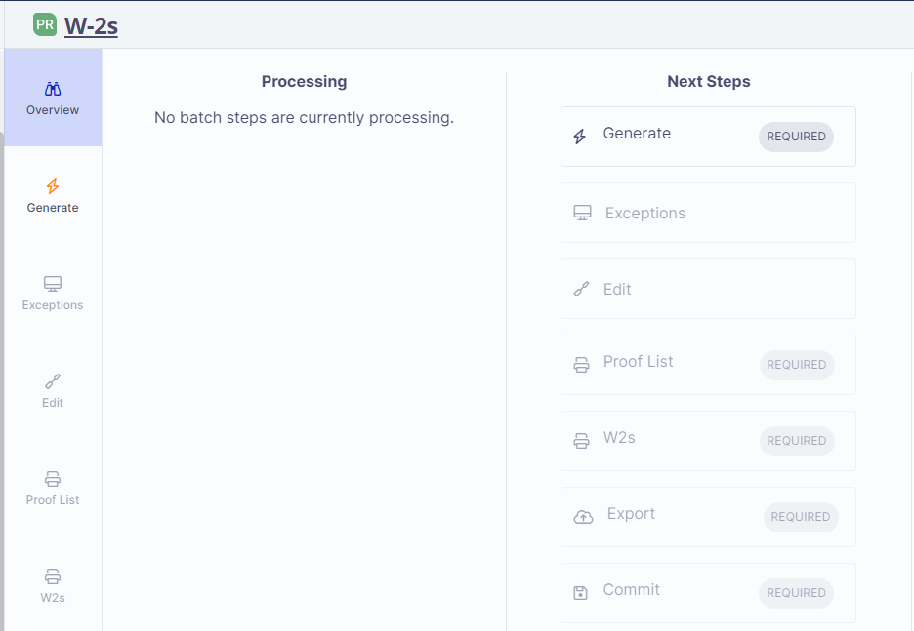
Once the Batch is created, you will then see the steps for the batch process. You will then need to click on Generate to begin.

Slide 39
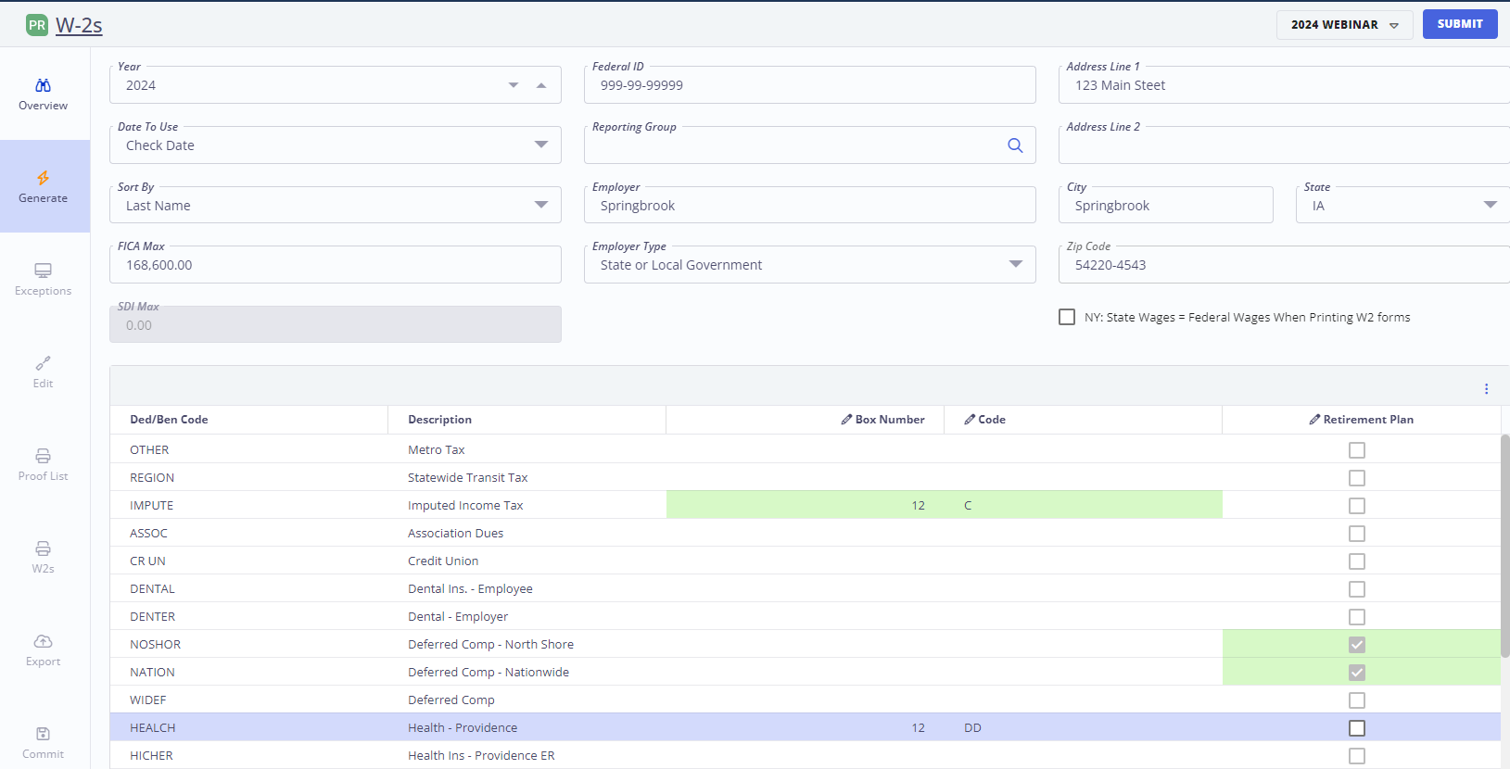
Within the Generate step, this is where you will confirm the Year, verify that your entity’s information is correct, enter in the FICA max and then for your deduction codes, as in Enterprise, fill in the Box Number and applicable code or if a retirement plan check the toggle. Once entered, click Submit.

Slide 40
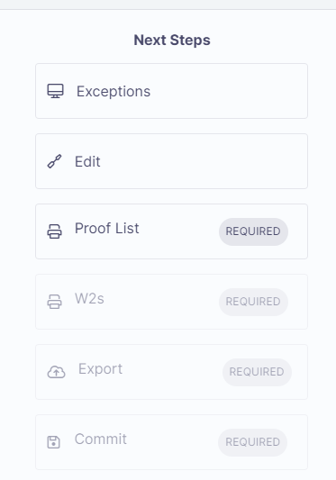
As in Enterprise, check to see if there are Exceptions. Be sure to review any Exceptions and make the necessary corrections.
The Edit step will provide the list of employees receiving a W-2 and their wages and taxes for the year. Just as in Enterprise, you have the option to go in to review and make corrections.
The next required step is the Proof List. Click on it to run.

Slide 41
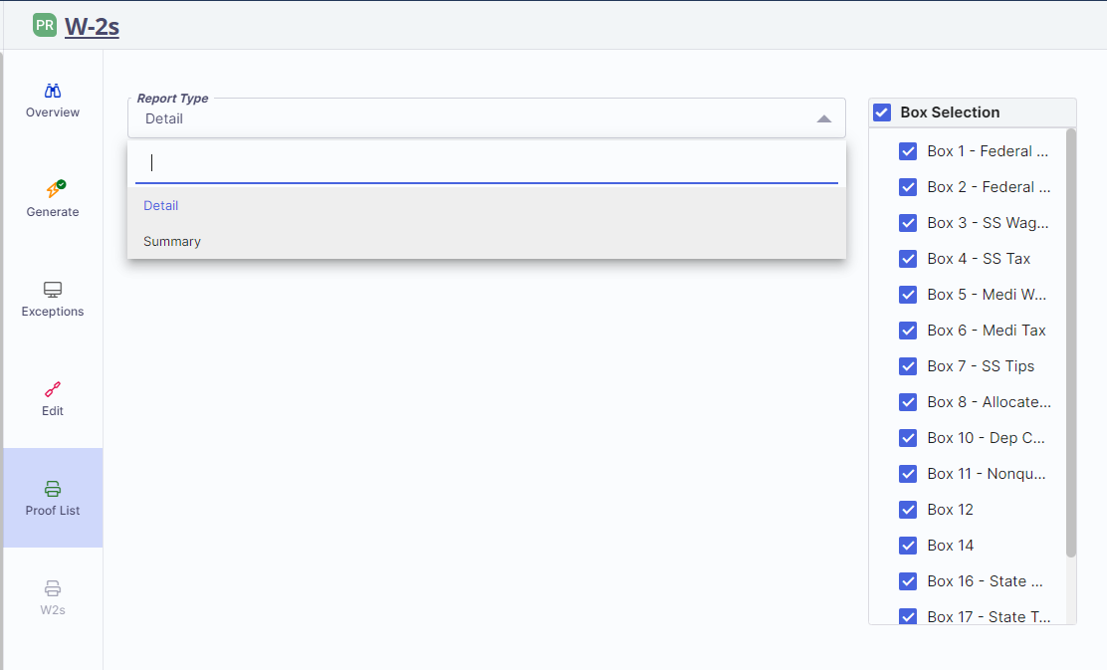
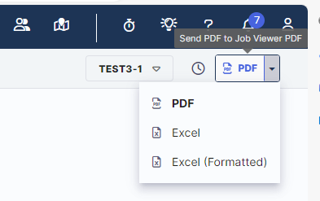
You have the option to run the Proof list by Detail or Summary. Make your selection then in the upper righthand corner there will be a drop down, where you can select how you would like to report to run, either in Excel or PDF.
At any time if you need to go back to a previous step, you can just click on the step here on the side and it will take you back.

Slide 42
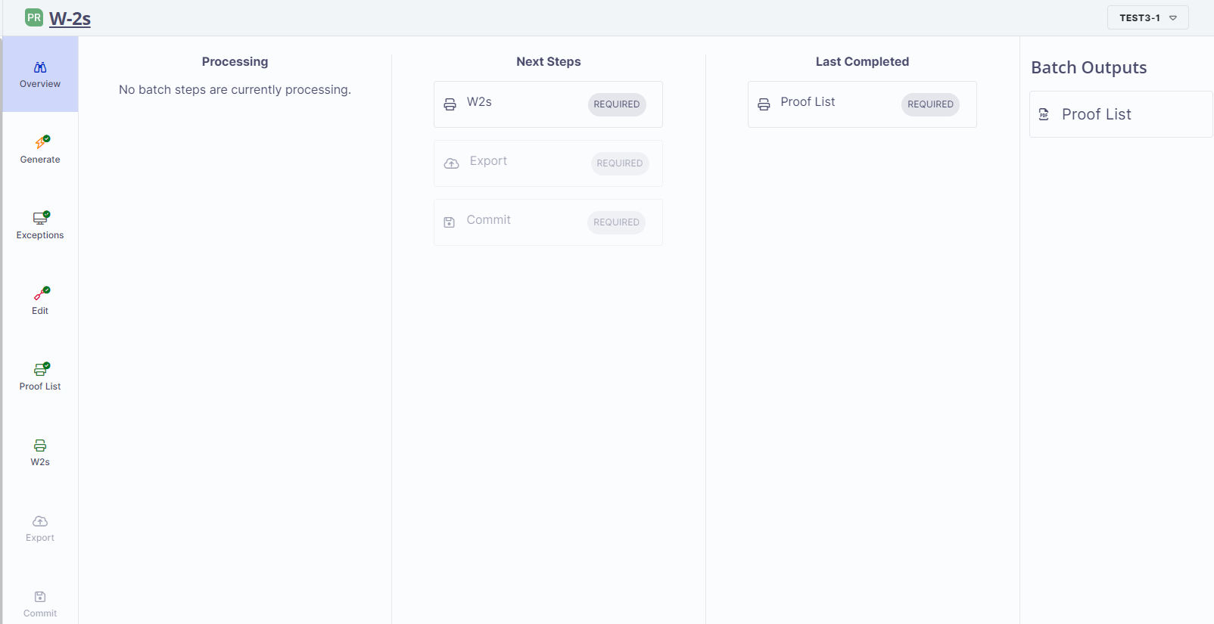
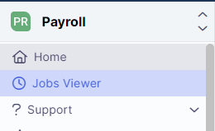
Once the Proof List is finished running, it will be accessible under Batch Outputs or under Jobs Viewer. If you ran the Summary Proof List, you can go back and run the Detail Proof List.
OR

Slide 43
The W-2s step is where you will create the file to be able to print the W-2s.
And the Export step is where you will enter in the information needed for the file to send to the IRS. Once entered select Submit.

Slide 44
Primary Colours
Secondary Colours
Thank you!
support@sprbrk.com

