Slide 1
Primary Colours
Secondary Colours
Springbrook – Pay Schedule

Slide 2
Agenda
Payroll Pay Schedule Setup
End of year batch numbering – Critical for Payroll
Tax Table Setups

Slide 3
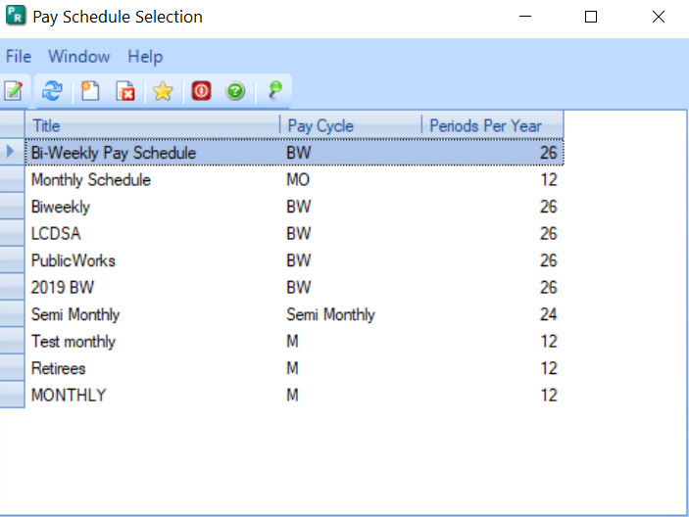
Pay Schedule Setup
Pay Schedules are located and updated in Payroll > Maintenance > Pay Schedule.
Pay Schedule Setup
Add new periods to the pay schedule
Add Timesheets to the pay schedule

Slide 4
Pay Schedule Tips
Pay Schedules are located and updated in Payroll > Maintenance > Pay Schedule.
Pay Schedules are set up by calendar year.
Pay Schedules need to be modified for the next year.
Make sure you set up the proper periods for the year.
If Bi-weekly you may have 26 or 27 periods for 2026. If so, use the copy feature then add another period to make the 27 periods.
Salary amounts – typically agencies pay the same amount rather than modifying it for the year.
NOTE: Pay Schedule Maintenance refers to Fiscal Year but actually means (and should say) Calendar Year. Corrected for versions 7.18 and cloud.

Slide 5
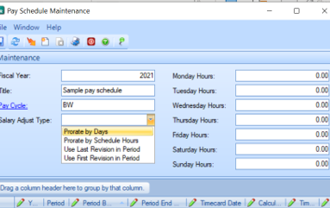
Pay Schedule Tips
Salary Adjust Type – This selection will determine how the salary button calculates salary amounts on timecards.
Prorate by Days – Prorates by total days in the period.
Prorate by Schedule Hours – Prorates based on the schedule on the right side.
Use Last Revision in Period
Use First Revision in Period

Slide 6
Add Periods to Schedule

Slide 7
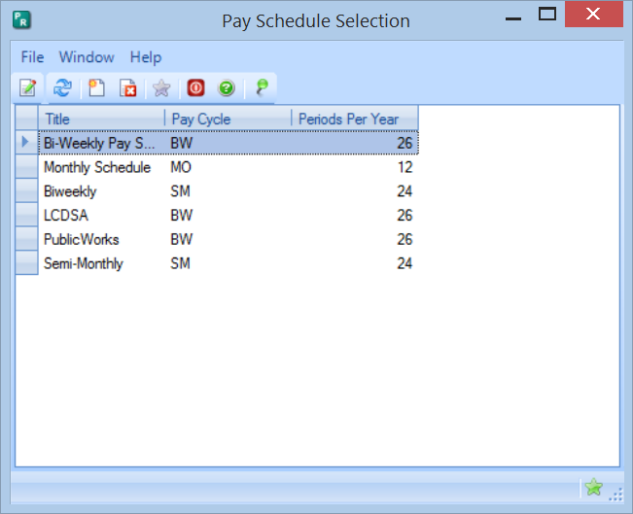
Open Pay Schedule to update
Do not set up a new pay schedule – you do not want to have to open every employee.
You will need to maintain each schedule used.

Slide 8
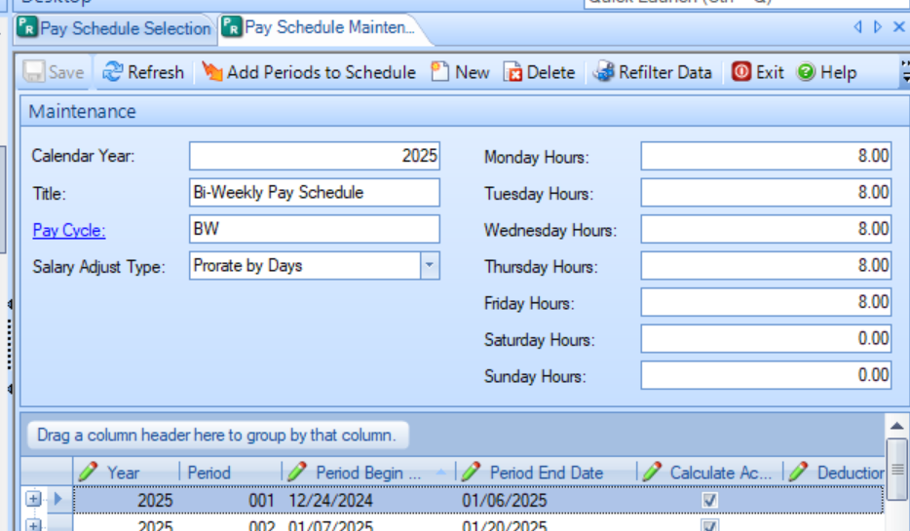
Click on the Add Periods to Schedule button

Slide 9
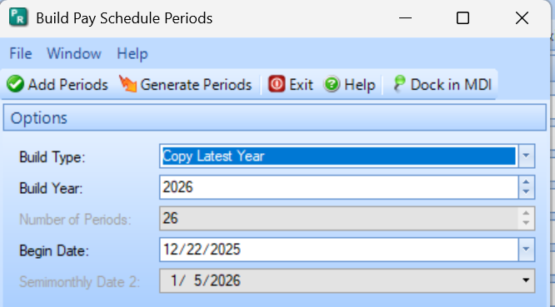
Select the Build Type
Copy Latest Year – Will copy the prior year with a date beginning after the current year dates.
This selection will not allow you to add periods or change dates but will copy Calculate Accruals, Timecard and Deduction Cycles from the current year.
Click the Generate New Periods button to create periods on the window.

Slide 10
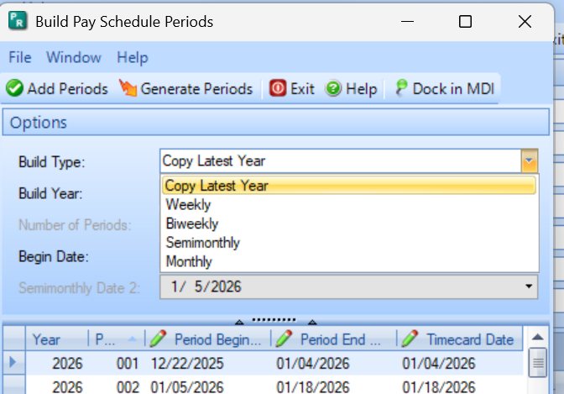
Build types other than Copy Latest Year
Other Build Types are available but generate different information. Other types do NOT copy the Timecard Dates and other schedule information but allow you to generate as many periods as you want (example is 27 biweekly periods to cover the pay periods for 2026).
Note: It still may be simpler to Copy, save and add the 27th period.

Slide 11
Build Types other than Copy Latest Year
Available Types
Weekly
Bi-Weekly
Semi-Monthly
Monthly
Generate Options
Can select the Number of Periods
Can change the Begin Date – Normally not necessary.
Will need to manually set Calculate Accruals, Timecard Cycles and Deduction Cycles before saving.
Can optionally change other information.

Slide 12
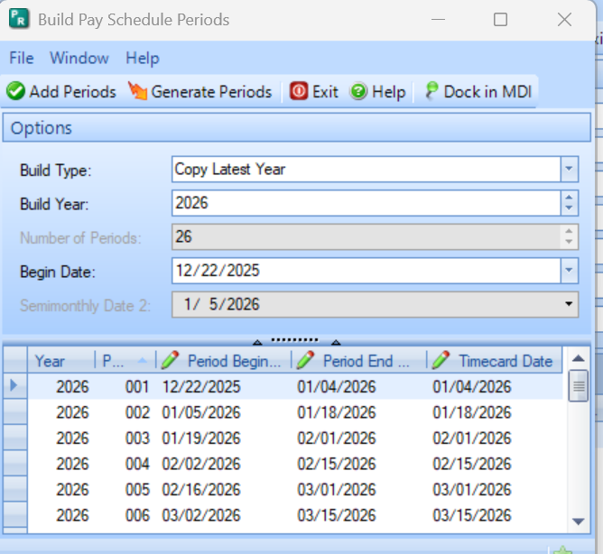
Adding Periods to the Pay Schedule
Click Generate new periods to have the new periods display in the window.
Once the periods desired are generated click Add Periods to add them to the selected Pay Schedule.
Tip: You can add them and not save in the next step if you find a problem.

Slide 13
Review and Modify new periods
Depending on the Build Type you must review the information to assure it is correct.
All fields are editable.
Timecard and Deduction cycles will likely change for Bi-Weekly or Weekly schedules each year. These must be correct to assure that the employees are paid and deducted properly.
It is not required to have Hours, Days and Weeks in the pay schedule.
Will copy from prior year.
If you key car allowance using the ‘Per Day Worked’ deduction calculation you will not want days filled in.

Slide 14
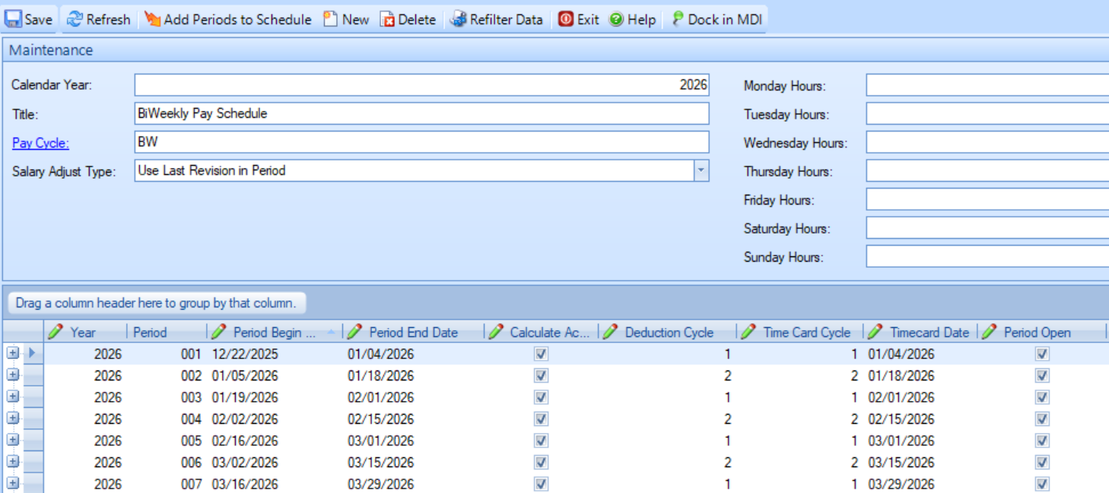
Make sure these are correct to avoid issues during Payroll
Check all fields but the most critical are:
Timecard Cycle
Deduction Cycle – Be aware of 3 pays in one month.
Close any periods you do not want employees to key time to.

Slide 15
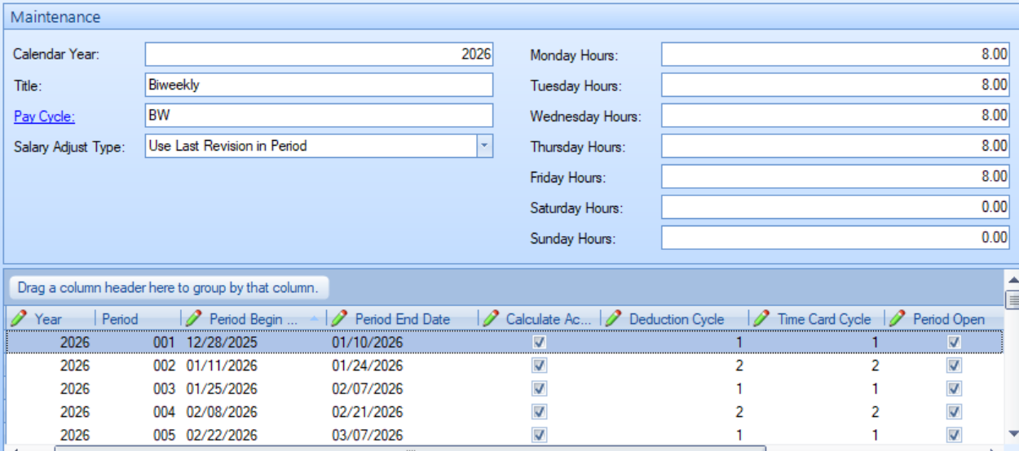
Saving the new Pay Schedule
After review, save the expanded Pay Schedule.
Expanding the current schedule will avoid having to make any changes to individual employees.

Slide 16
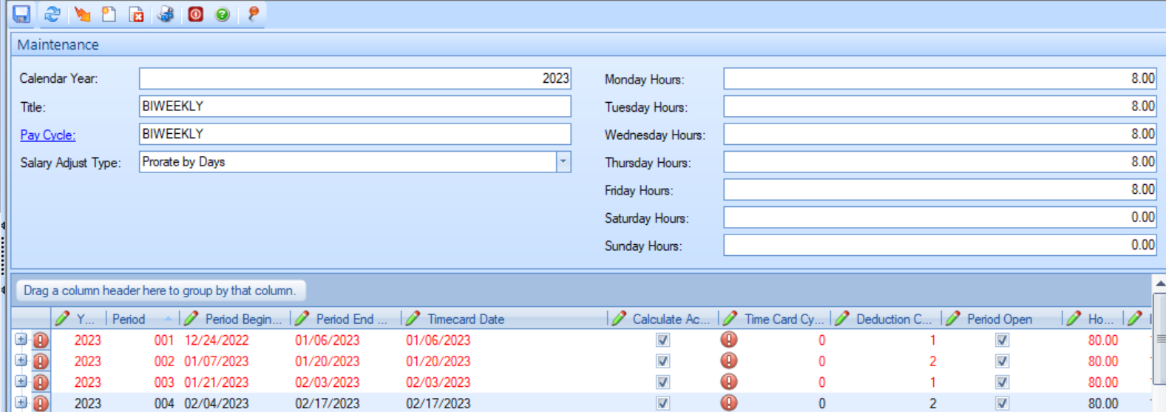
Save Errors
If not using the Copy option you must complete Time Card Cycles before saving.
This is the disadvantage of generating 27 periods for biweekly payrolls rather than copying and adding the extra period.
Note this screenshot is old but the errors show what will happen if the timecard cycle is not updated.

Slide 17
Add Timesheet Periods

Slide 18
Do I need to add Timesheet Periods?
Timesheet periods are required if time entry is being processed outside of the Computer Checks process. Timesheet periods are not copied from the prior year. (There is an option in Cirrus to add timesheets to your Pay Schedule.)
Employee Self Service – ESS will not recognize or display the new pay schedule until timesheet periods are added.
Employees or clerks enter time in Timesheets or Quick Time Entry.
Some custom time clock imports require timesheet periods.
Not required if you import timecards into the Computer Check process. This is standard in versions 7.17.0 and up.

Slide 19
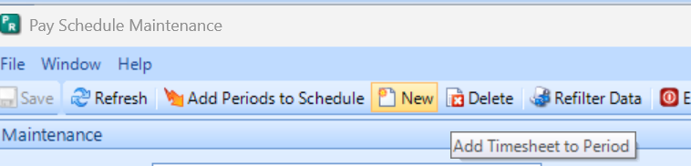
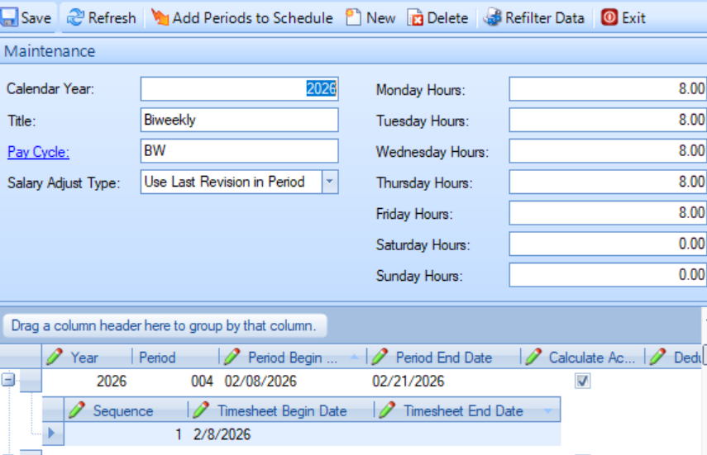
New Timesheet Periods
Highlight period.
Click New
Expand the plus sign for pay period.
Add Timesheet Begin and End Dates.
This will take time but is required if using timesheets.

Slide 20
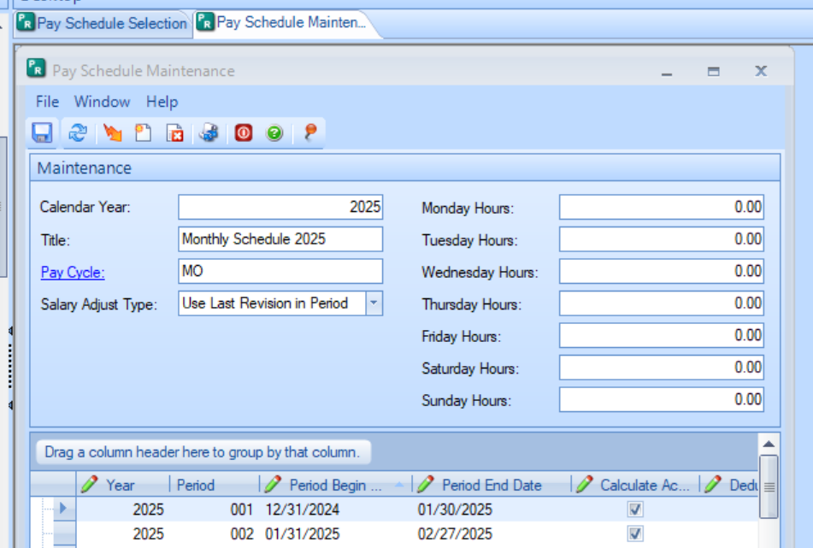
Change the Title of a Pay Schedule
Available in versions 7.17.0 and up.
The Title of the Pay schedule can be modified in these versions.

Slide 21
End of Year Batches

Slide 22
Batch Number affects on Payroll
Batch numbers are CRITICAL to year end payroll batches.
Make sure your batch year matches the check year for the checks.
Year-to-date amounts on the checks will display by batch year.
The batch year will set the annual maximums calculated in the process.
FICA
MEDI
Deferred Compensation

Slide 23
Make sure your Payroll batch year matches the check year for the checks.
Look at the checks or ACH checks printed before committing, to confirm that the YTD totals have started over.
Support has a utility that can change batch numbers/years when the payroll is open for later versions but cannot change committed information.
December 31 is a Wednesday.
If batch is generated in 2025 for checks dated 1/2/2026 the information will be incorrect when calculated in Payroll.
The batch month and year must equal the check date.

Slide 24
W2 Preparation

Slide 25
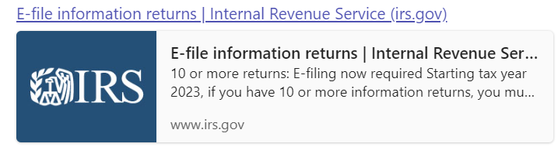
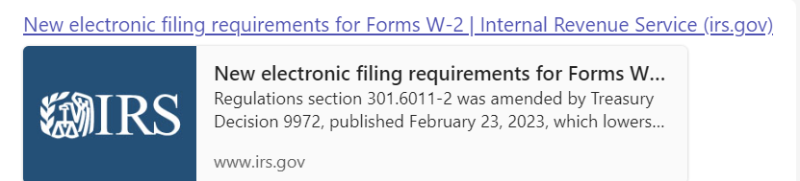
IRS Regulations were amended in 2024, lowering the threshold to 10 Employees. Meaning that if you have 10 or more W-2s to issue, you must file electronically.

Slide 26
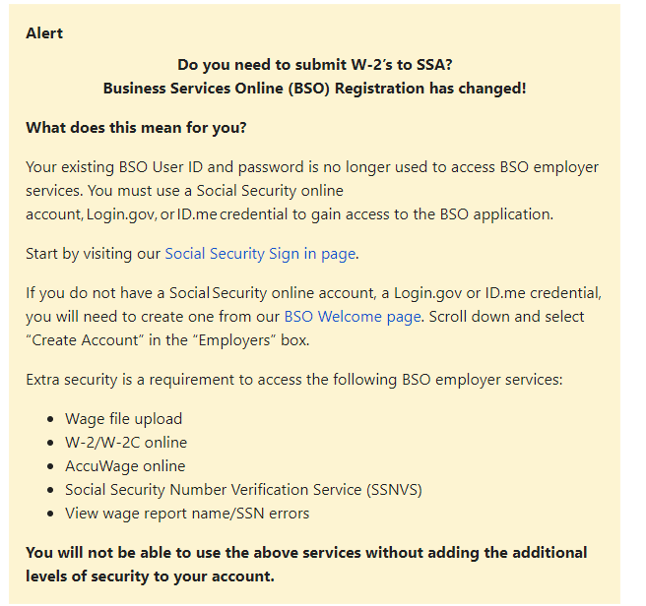
There is also a change to how an employer can access Business Services Online (BSO) in order to be able to submit W-2’s to the Social Security Administration.
Go to Business Services Online for more information and the steps to create/use a Social Security online account, Login.gov, or ID.me credential to gain access to the BSO application.
We would encourage you to create your accounts sooner rather than later as this would eliminate frustration when it comes time to file W-2s.

Slide 27
W2 Checklist
Reporting Deadlines – Make sure to file electronically by January 31, 2026.
Check your state for their deadlines but assume it is also January 31.
Purchase forms if desired. Use SOLV. Click here to order.
Download the instructions from IRS.com.
https://www.irs.gov/pub/irs-pdf/iw2w3.pdf
Balance and make sure Payroll information is complete and balanced.
Use the Manual Check process to make an adjustments if needed.
Get all adjustment information into Payroll History to make W2 processing simple. If you have no adjustments, no action will be needed.

Slide 28
Manual Check Adjustments
Commonly needed quarterly to balance.
Some disability, third party sick pay and worker’s comp payments require entries.
Sometimes Support can assist if you have a pay or deduction code that was not marked properly during the period.
We have an Admin utility that can modify Payroll history on employees.
Need to caution if you have some employees that do not have FICA/MEDI if using the Admin utility tool.

Slide 29
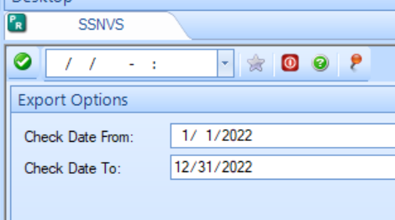
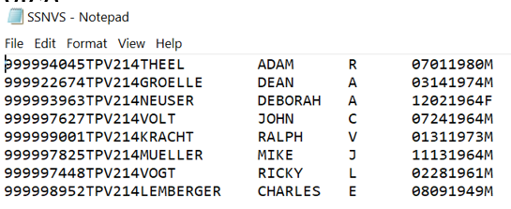
SSNVS – Social Security Number Verification Service
Export available in Payroll > Utilities > SSNVS. It is in the same place in Cirrus.
Exports a file that can be uploaded to BSO SSNVS for Social Security Number verifications prior to sending W2s.
*In order to use the BSO SSNVS service, you must have created the NEW Social Security online account, a Login.gov or ID.me credential.*

Slide 30
BSO – Business Services Online
Check now to make sure you can log In to BSO.
You can add additional services (SSN checking) if you need it.
https://www.ssa.gov/bso/bsowelcome.htm
Accuwage – Where you upload the W2 file export.
Must log in to BSO to get to Accuwage Online.
Instructions on the page linked below.
https://www.ssa.gov/employer/accuwage/index.html

Slide 31
Tax Tables

Slide 32
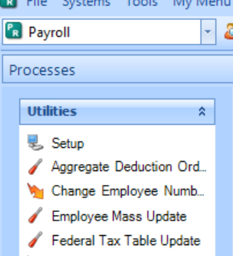
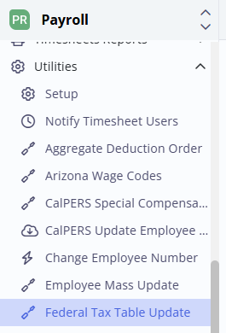
2026 Tax Tables
Withholding tables have not been published yet.
In versions 7.17 and below tax tables cannot be modified until your last payroll in December is completed. Versions 7.18 and cloud have revisions so can be modified at any time with
a new revision and date.
Tax Table setups will have documentation in December.
Currently no webinars are scheduled to cover tax tables.

Slide 33
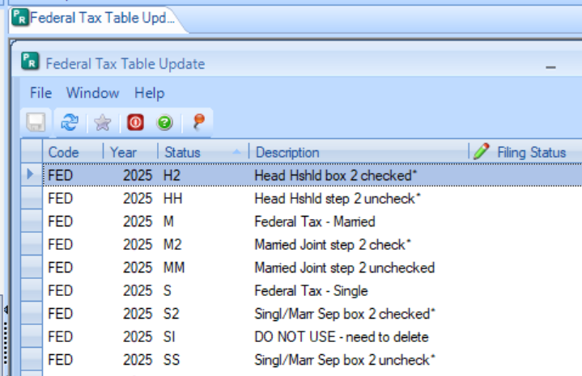
New Menu Option Payroll > Utilities > Federal Tax Table Update
Available for 7.18 and Cloud databases only.
New menu item – You will need to change Menu Security to access it.
Will NOT update State tax tables.
When the Year says 2026 (the next calendar year), the tables are available to update.
This window says 2025 which indicates the 2026 tax tables are not available yet.

Slide 34
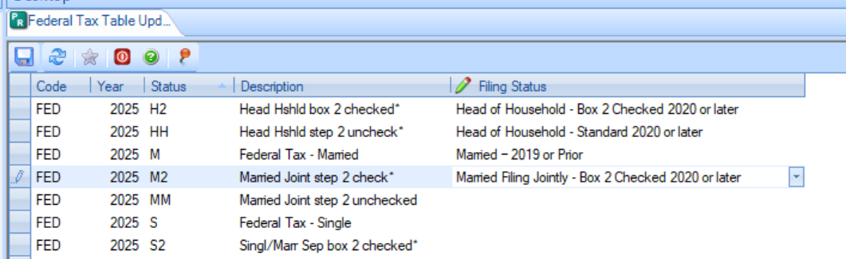
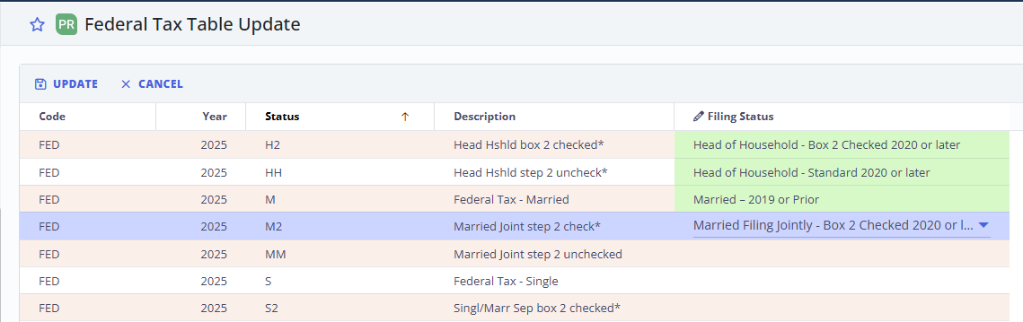
Federal Tax Table Update
Federal Tax Table Update
Select your tax table that matches the code in the window. These are the codes and descriptions on your tax tables.
Click in the Filing Status box to display the down arrow to select the table with the update information.
Select each table to update. You can do this in several steps if desired.

Slide 35
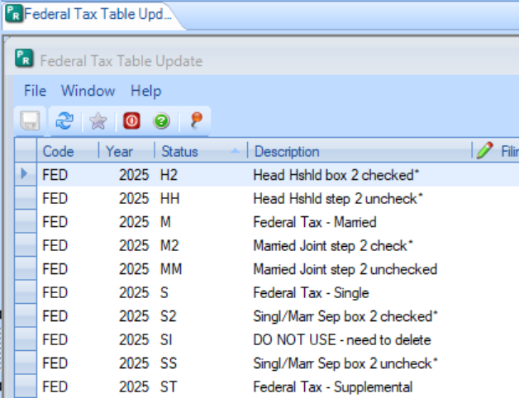
Federal Tax Table Update
Available selections match Publication 15-T table information.
Standard indicates Box 2 is unchecked.
Single – Standard
Married Filing Jointly – Standard
Head of Household – Standard
Married Filing Separately (same as single)
Married Filing Jointly-Box 2 checked
Head of Household-Box 2 checked
Married Filing Separately – Box 2 checked

Slide 36
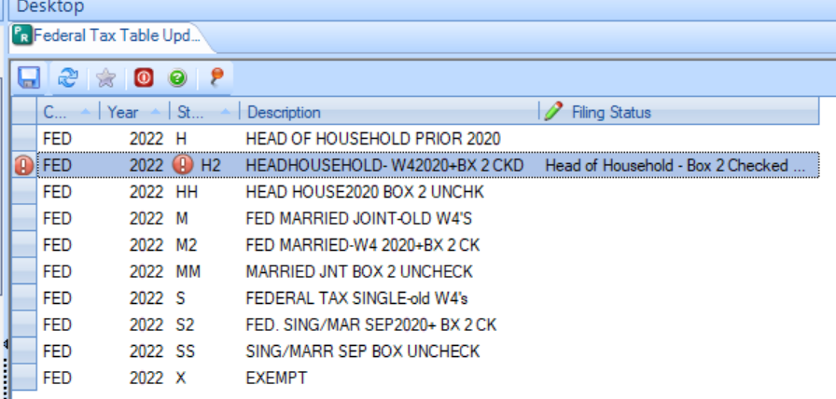
Federal Tax Table Update
Save your changes.
If you receive an error, check your prior year revision dates.
The prior year revision dates should not have the new tax year.

Slide 37
Other Year End Changes
FICA/FICAR Annual or Salary Max.* - Can set up new revision but be sure to change the Annual and/or Salary Max to the current year value before any employees will reach that pay amount.
Deferred Comp Annual Max. – New revision or change the deferred comp maximum before anyone will reach it.
Note: If using Aggregate deductions make sure you change the right one.
New York Retirement Tier Limits – Update to the new year limits.
Workers Comp table changes*- If changes are due.
Items marked with * are commonly changed after the quarterly reporting is completed for the 4th quarter of the prior year. Changing them before that can display incorrectly (depending on your versions) in the reports.

Slide 38
Questions?

Slide 39
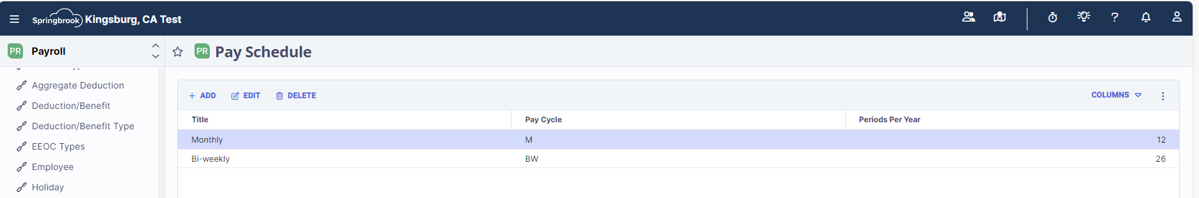
Updating Pay Schedules in Cirrus
In Cirrus, go to Payroll > Maintenance > Pay Schedules. Select the Pay Schedule you want to update and then select Edit:

Slide 40
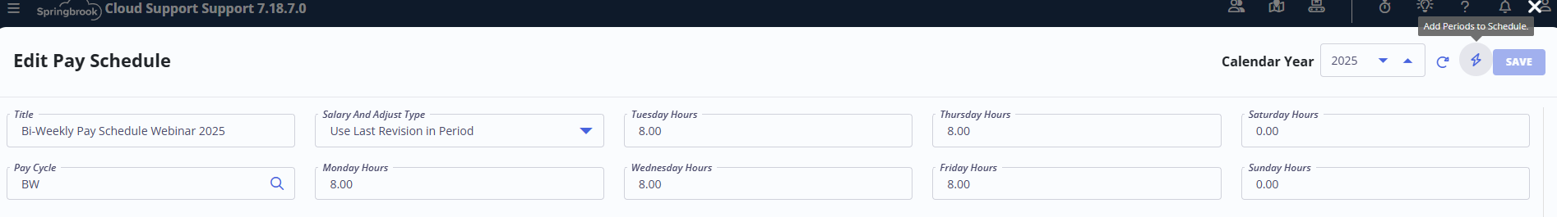
On the Edit Pay Schedule screen, the Calendar Year should be the current year and you will want to click on the lightening bolt icon, which will Add Periods to Schedule.

Slide 41
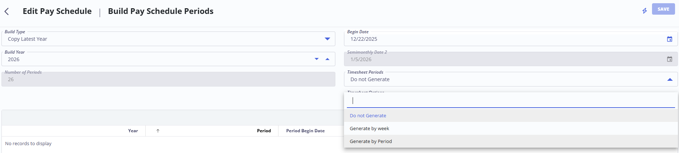
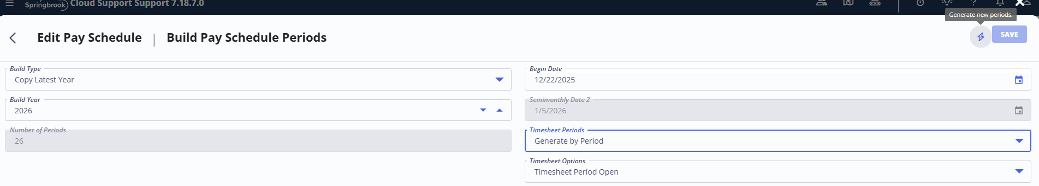
If you need Timesheet Periods to be populated, select the option Generate by Period (this option is the most common).
Once you have made your selection, again click on the lightening bolt icon to Generate New Periods.

Slide 42
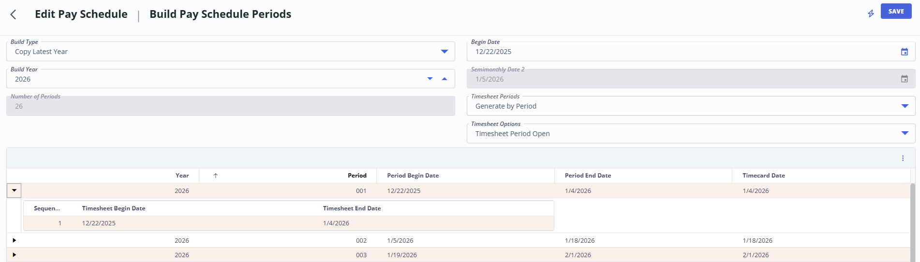
Once the lightening bolt has been clicked on, the system will generate the pay schedules, and if you expand under each Period, you will see the Timesheet Begin/End Date. If adjustments are needed, they cannot be made until you select Save.

Slide 43
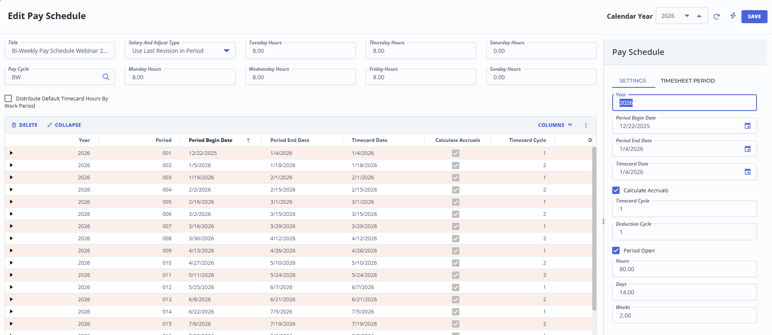
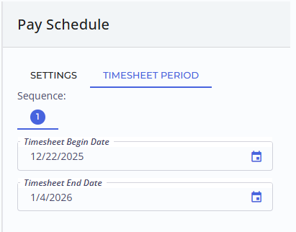
If you need to make updates to the Period Begin and End Dates, Timesheet Begin/End Dates, Timecard Cycle, Deduction Cycle or uncheck toggles for Calculate Accruals or Period Open, then you will have to Double Click on the Row that you want to update.
When you Double Click, a box will pop up on the righthand side of the screen in which you can make your changes. The Settings allows changes to the Period Dates, etc. and the Timesheet Period allows changes to the Timesheet Begin and End Dates.

Slide 44
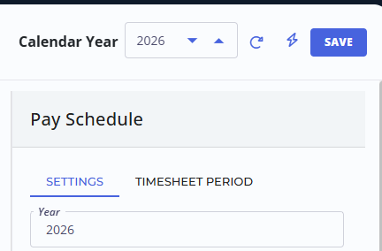
Once changes have been made, or if everything is correct in general, select SAVE in the upper righthand corner.
If you notice that the Save button is not illuminated, uncheck one of the toggles and recheck it. This will prompt the Save button to illuminate.

Slide 45
Primary Colours
Secondary Colours
Thank you!
support@sprbrk.com

